Slide 1

A continuous local ancestry measure and efficient local-ancestry-aware association tests
Dissertation Presentation
Hanxiao Sun
Department of Biostatistics and Data Science, School of Public Health
University of Texas Health Science Center at Houston
04/15/2024

Slide 2
Terminology
Glossary
Global ancestry: the fraction of genomic ancestry that can be ascribed to each of the ancestral populations contributing to the recently admixed population
Local ancestry: the genetic ancestry of an individual at a particular chromosomal location
Local ancestry inference (LAI): local ancestry estimates generated by certain software
Global PCs: genomic Principal Component Analysis components in terms of global ancestry
Local PCs: genomic Principal Component Analysis components in terms of local ancestry at a specific locus
Discrete population ancestry assignment: discrete format of local ancestry inferences
Continuous population ancestry assignment: aggregated form of local ancestry inferences
Global ancestry coordinates: genomic components from PCA projection in terms of global ancestry
Local ancestry coordinates: genomic components from PCA projection in terms of local ancestry

Slide 3
Outline
Introduction
Public Health Significance
Specific Aims
Aim 1: Development and evaluation of continuous measurement that delineates local population landscape
Rationale
Simulation
Simulation Results
Aim 2: Development and application of computational-efficient local-ancestry-aware GWAS models
Rationale
Type-I Error Simulation
Type-I Error Simulation Results
Aim 3: Application on Hispanic Community Health Study / Study of Latinos (SOL) cohort
Introduction
Results
Further Exploration
Discussion
Limitations
Future works

Slide 4
Introduction
GWAS (Genotype-wide Association Studies)
Associate systematic allele frequencies discrepancies with phenotypes of interest
Identify disease-related single nucleotide polymorphisms (SNPs)
Can be easily confounded by population heterogeneity within test samples, e.g. population stratification
Population stratification
Systematic differences in allele frequencies within subpopulations
May lead to false-positive results or failure to detect true associations
Table 1. Examples of false-positive results confounded by population stratification
Author | Phenotype | Populations | Confounder
Knowler et al. (1988) | Type-2 diabetes | American Indians | Gm haplotypes admixed between Pima and Papago Indians and Europeans
Campbell et al. (2005) | Height | European Americans | Widely varying LCT gene across Europeans

Slide 5
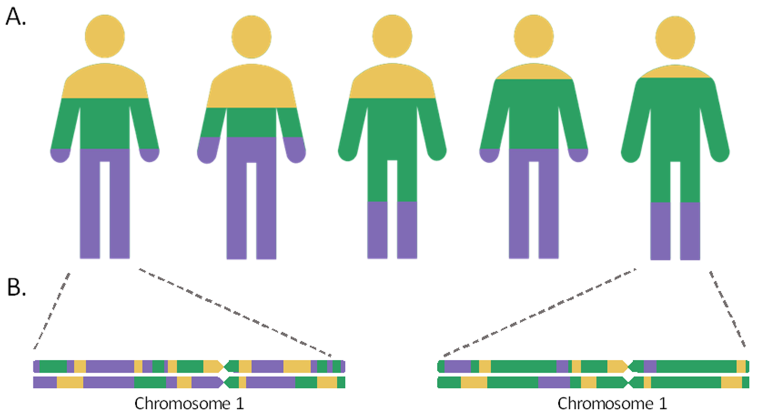
Introduction
Admixed populations
Mosaic of chromosomal segments from multiple ancestries
Tracts: regional segments from the same ancestry
Breakpoints: genomic positions of local ancestry transitions
Elevate population stratification in local ancestry scales
Take 1/3 of the US but disproportionally understudied
Expansive waves for admixed populations
Admixed populations are experiencing higher risks for certain diseases
Tract
Breakpoint
Fig 1. Diagram of admixed population genetic architecture (cr. MDPI)
Table 2. List of country-level admixed populations numbers
Country | Increase rate/% | Total number/Million | Percentage/%
US | 273 (2010-2020) | 33.8 | 10.2
Brazil | 43.1% (2010-2022) | 92.1 | 45.3
UK | 40% (2011-2021) | 1.72 | 2.9
Table 3. List of increasing risks between admixed populations and diseases
Disease | Admixed populations | Disease | Admixed populations | Disease | Admixed populations
Systemic lupus erythematosus | Caribbeans | Type 2 diabetes | American Indians | Rheumatoid arthritis | American Indians
Prostate cancer | African Americans |  | Pacific islanders | Central adiposity | South Asian & west African
Keloid scarring | African Americans |  | Australia natives | Coronary disease | South Asian & west African

Slide 6
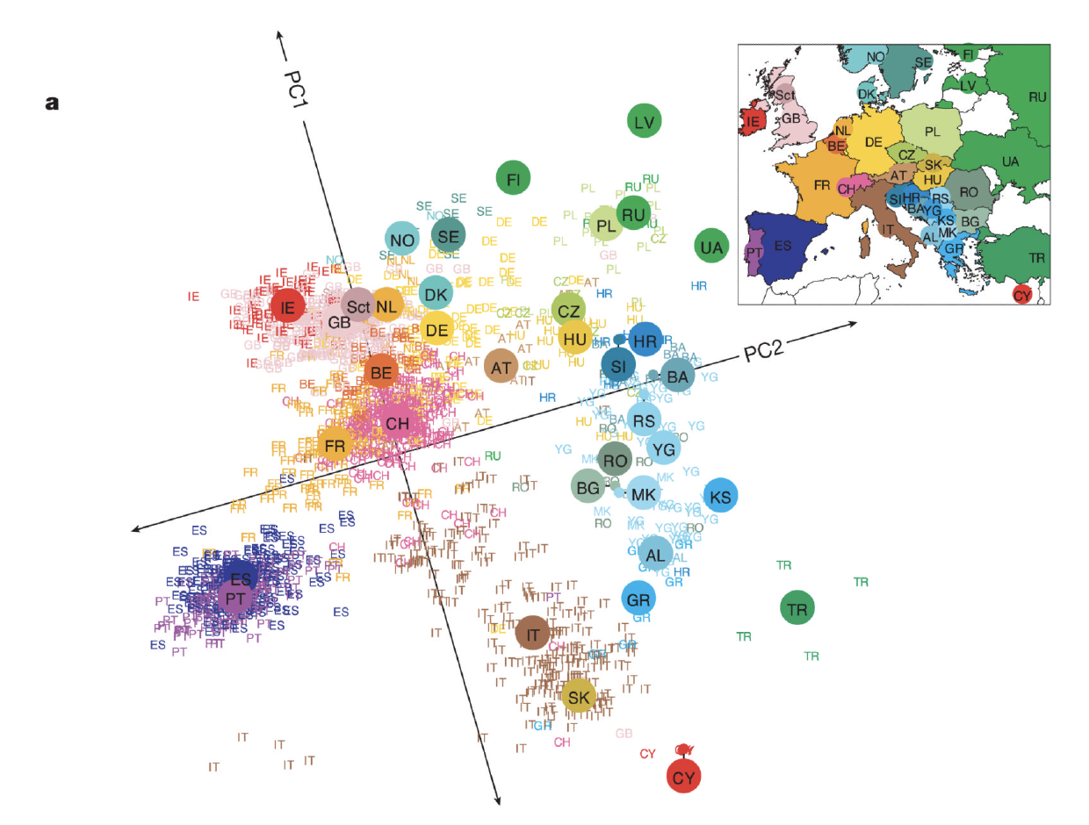
Introduction
Development of approaches to control population structure
Stage 1: adjust global population structures
1999
2006
Genomic control (Delvin & Roeder, et al.)
Uniform adjustments by variant inflation factors from flanking regions
PCA (Price, et al.)
Adjust global PCs
Appealing background information
Software: Eigenstrat, Structure
Fig 2. PCA outcome of European
(cr: Novembre et al. Nat Genet)
Stage 2: adjust local population structures
2011
2013
2014
Logistic-Local (Wang, et al.)
Model conditional phenotypic distribution with dosage allele numbers
Adjust local ancestry from flanking regions
Genotype-Allelic-Only (GAO, Li, et al.)
Only include global PCs
Standard GWAS models
Local-Ancestry-Only (LAO, Chen, et al.)
Only adjust local ancestry from population of interest
Admixture mapping models
2014
2017
2021
Ancestry Plus Allelic (APA, Levin)
Combine GAO and LAO models
Local Ancestry Adjusted Allelic (LAAA, Duan)
Extension of APA model
Additionally adjusted with ancestry-specific allelic effects
Tractor (Atkinson)
Extension of admixture mapping
Adjust both ancestry-specific genotype and local ancestry

Slide 7
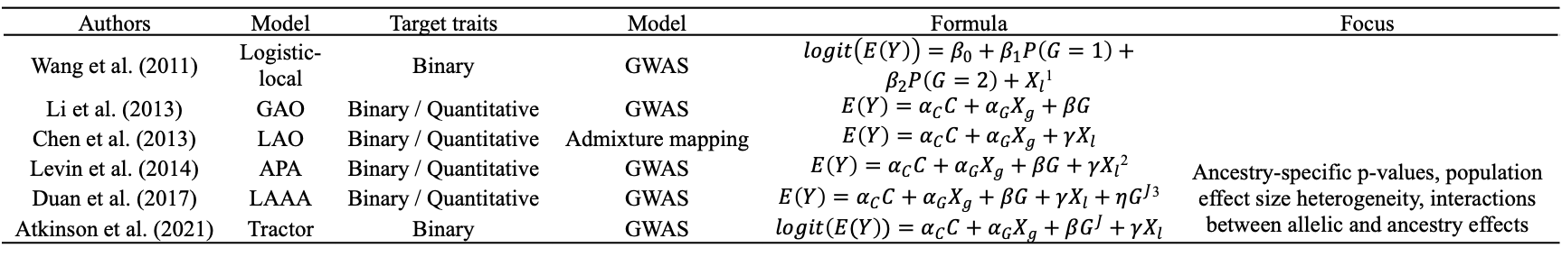
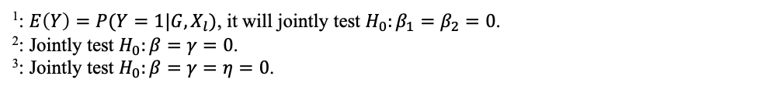
Introduction
Development of approaches to control population structure
2010
2013
Time
Adjusting variation in global population structure
Adjusting mosaic chromatin effects among admixed population
Proxy global structure in flanking regions
Proxy local ancestry in flanking regions
Real local ancestry estimates
Genome Control (1999)
PCA (2006)
Logistic-local (2011)
GAO, LAO (2013)
APA (2014)
LAAA (2017)
Tractor (2021)
Table 4. General formulae of existing models
Authors | Model | Target traits | Model | Formula | Focus
Wang et al. (2011) | Logistic-local | Binary | GWAS | $logit\left(E\left(Y\right)\right)=β_{0}+β_{1}P\left(G=1\right)+β_{2}P\left(G=2\right)+X_{l}$¹
Li et al. (2013) | GAO | Binary / Quantitative | GWAS | $$E\left(Y\right)=α_{C}C+α_{G}X_{g}+βG$$
Chen et al. (2013) | LAO | Binary / Quantitative | Admixture mapping | $E\left(Y\right)=α_{C}C+α_{G}X_{g}+γX_{l}$
Levin et al. (2014) | APA | Binary / Quantitative | GWAS | $E\left(Y\right)=α_{C}C+α_{G}X_{g}+βG+γX_{l}$² | Ancestry-specific p-values, population effect size heterogeneity, interactions between allelic and ancestry effects
Duan et al. (2017) | LAAA | Binary / Quantitative | GWAS | $E\left(Y\right)=α_{C}C+α_{G}X_{g}+βG+γX_{l}+ηG^{J}$³
Atkinson et al. (2021) | Tractor | Binary | GWAS | $logit\left(E(Y\right))=α_{C}C+α_{G}X_{g}+βG^{J}+γX_{l}$
¹: $E\left(Y\right)=P(Y=1|G,X_{l})$, it will jointly test $H_{0}:β_{1}=β_{2}=0$.
²: Jointly test $H_{0}:β=γ=0$.
³: Jointly test $H_{0}:β=γ=η=0$.
$Y=phenotype of interest,G=\left(0, 1, 2\right)=number of dosage allele at a specific genomic position, J=ancestry of interest$
$C=covariates, X_{g/l}=global/local ancestry related estimates, e.g. global PCs$

Slide 8
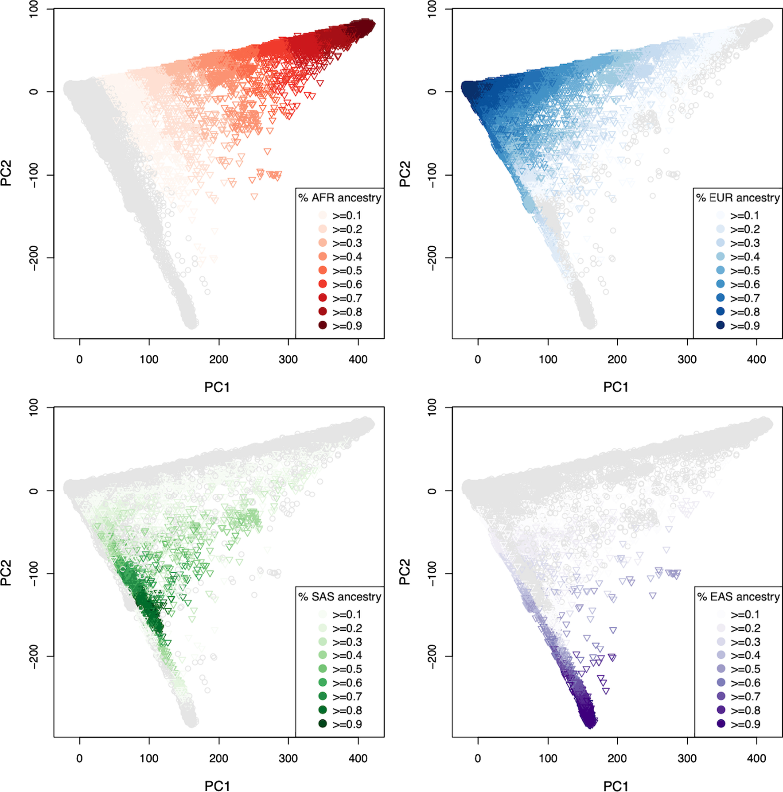
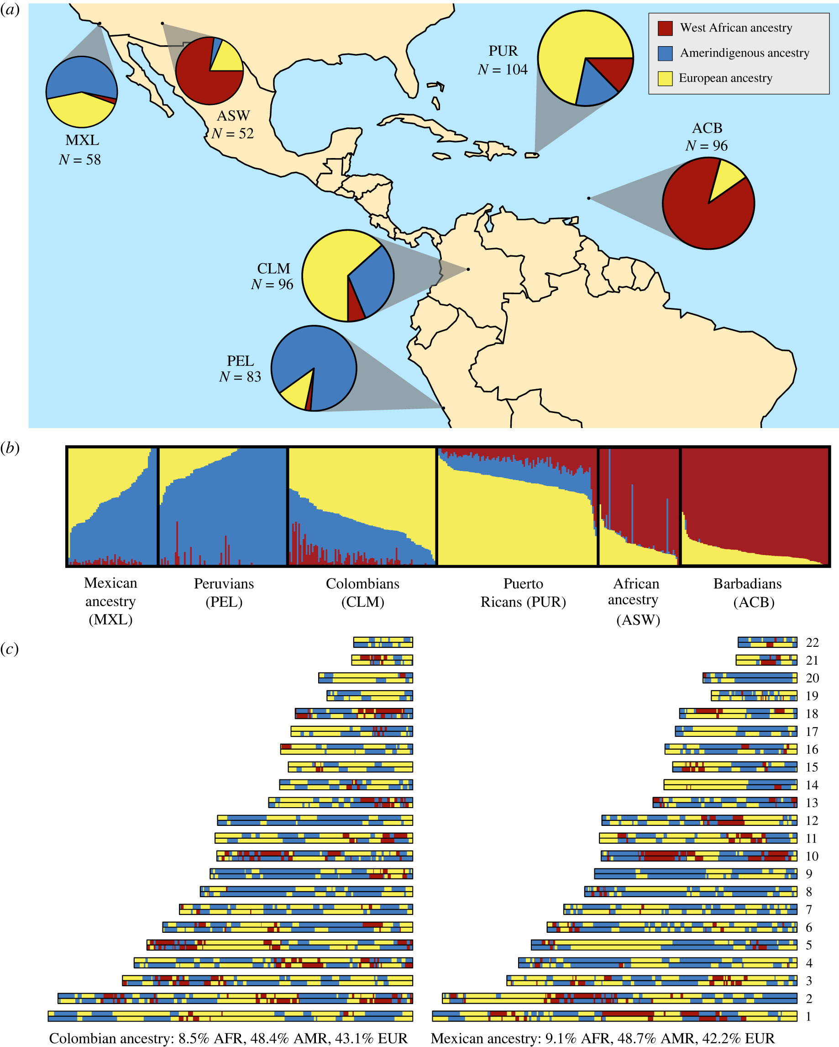
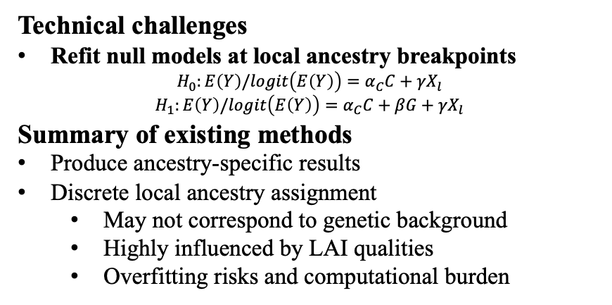
Introduction
Technical challenges
Refit null models at local ancestry breakpoints
$H_{0}:E\left(Y\right)/logit\left(E\left(Y\right)\right)=α_{C}C+γX_{l}$
$H_{1}:E\left(Y\right)/logit\left(E\left(Y\right)\right)=α_{C}C+βG+γX_{l}$
Summary of existing methods
Produce ancestry-specific results
Discrete local ancestry assignment
May not correspond to genetic background
Highly influenced by LAI qualities
Overfitting risks and computational burden
What are we looking for
Statistical framework that circumvents refitting null models
Approaches to comprehensively control population stratification impacts
Aggregated measurement
Truly reflect relationship between global and local ancestry
Reveal geographical information
Computational efficient
Fig 3. Ancestry composition of Central American
(cr: Gopalan et al. Royal Society)
Fig 4. Distribution of continental PCs
(cr: Constantinescu et al. Hum Genet)

Slide 9
Significance and target
Public health significance
Control false positive rates and produce novel genetic findings
Facilitate development of precision medicine and reducing health disparity
NHGRI-EBI GWAS Catalog (01/2022):
European ancestry (95.82%), Asian ancestry (3.05%), African, other/mixed ancestry(<1%)
Assist in understanding population migration, Anthropology, etc.
Avoid stigmatization by associating population structure with phenotypes
Specific aims
Aim 1: Development and evaluation of continuous measure that delineates local population structure landscape
Aim 2: Development and evaluation of computational-efficient local-ancestry-aware GWAS models
Aim 3: Application on Hispanic Community Health Study / Study of Latinos (SOL) cohort

Slide 10
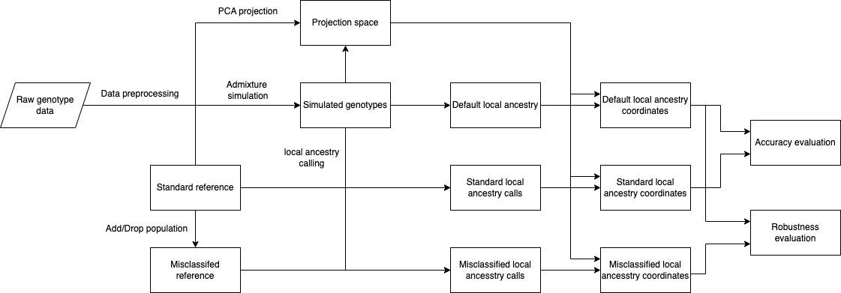
Aim 1: Design continuous local ancestry measure
Introduction
Merits & drawbacks of PCA:
Present demographical/geographical background information
Highly subject to query data, sample sizes, outliers, etc. and questionable reproducibility
Likely to bias downstream analysis if improper reference panel used
Core ideas
Local ancestry coordinates (LACs): genomic components from PCA projection in terms of local ancestry
Introduce a proper reference panel and corresponding global PCs spanned spaces
Project study samples onto the fixed reference-based global PC spaces
Refine the ancestry projection matrix from global PCs and project local ancestry onto the same spaces
Fig 5. Overview of Aim1

Slide 11
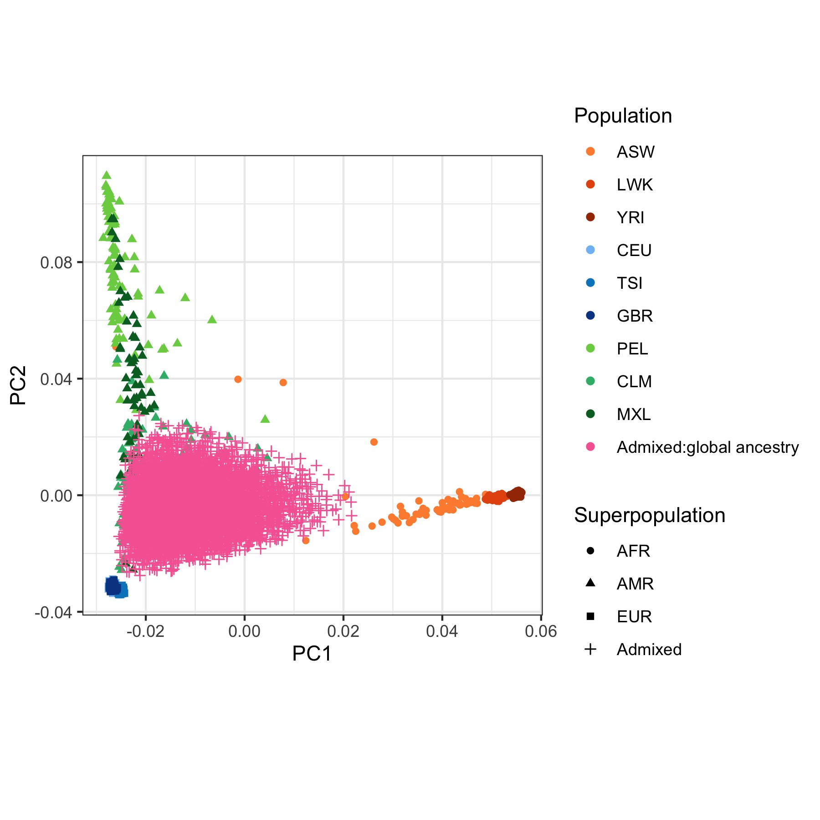
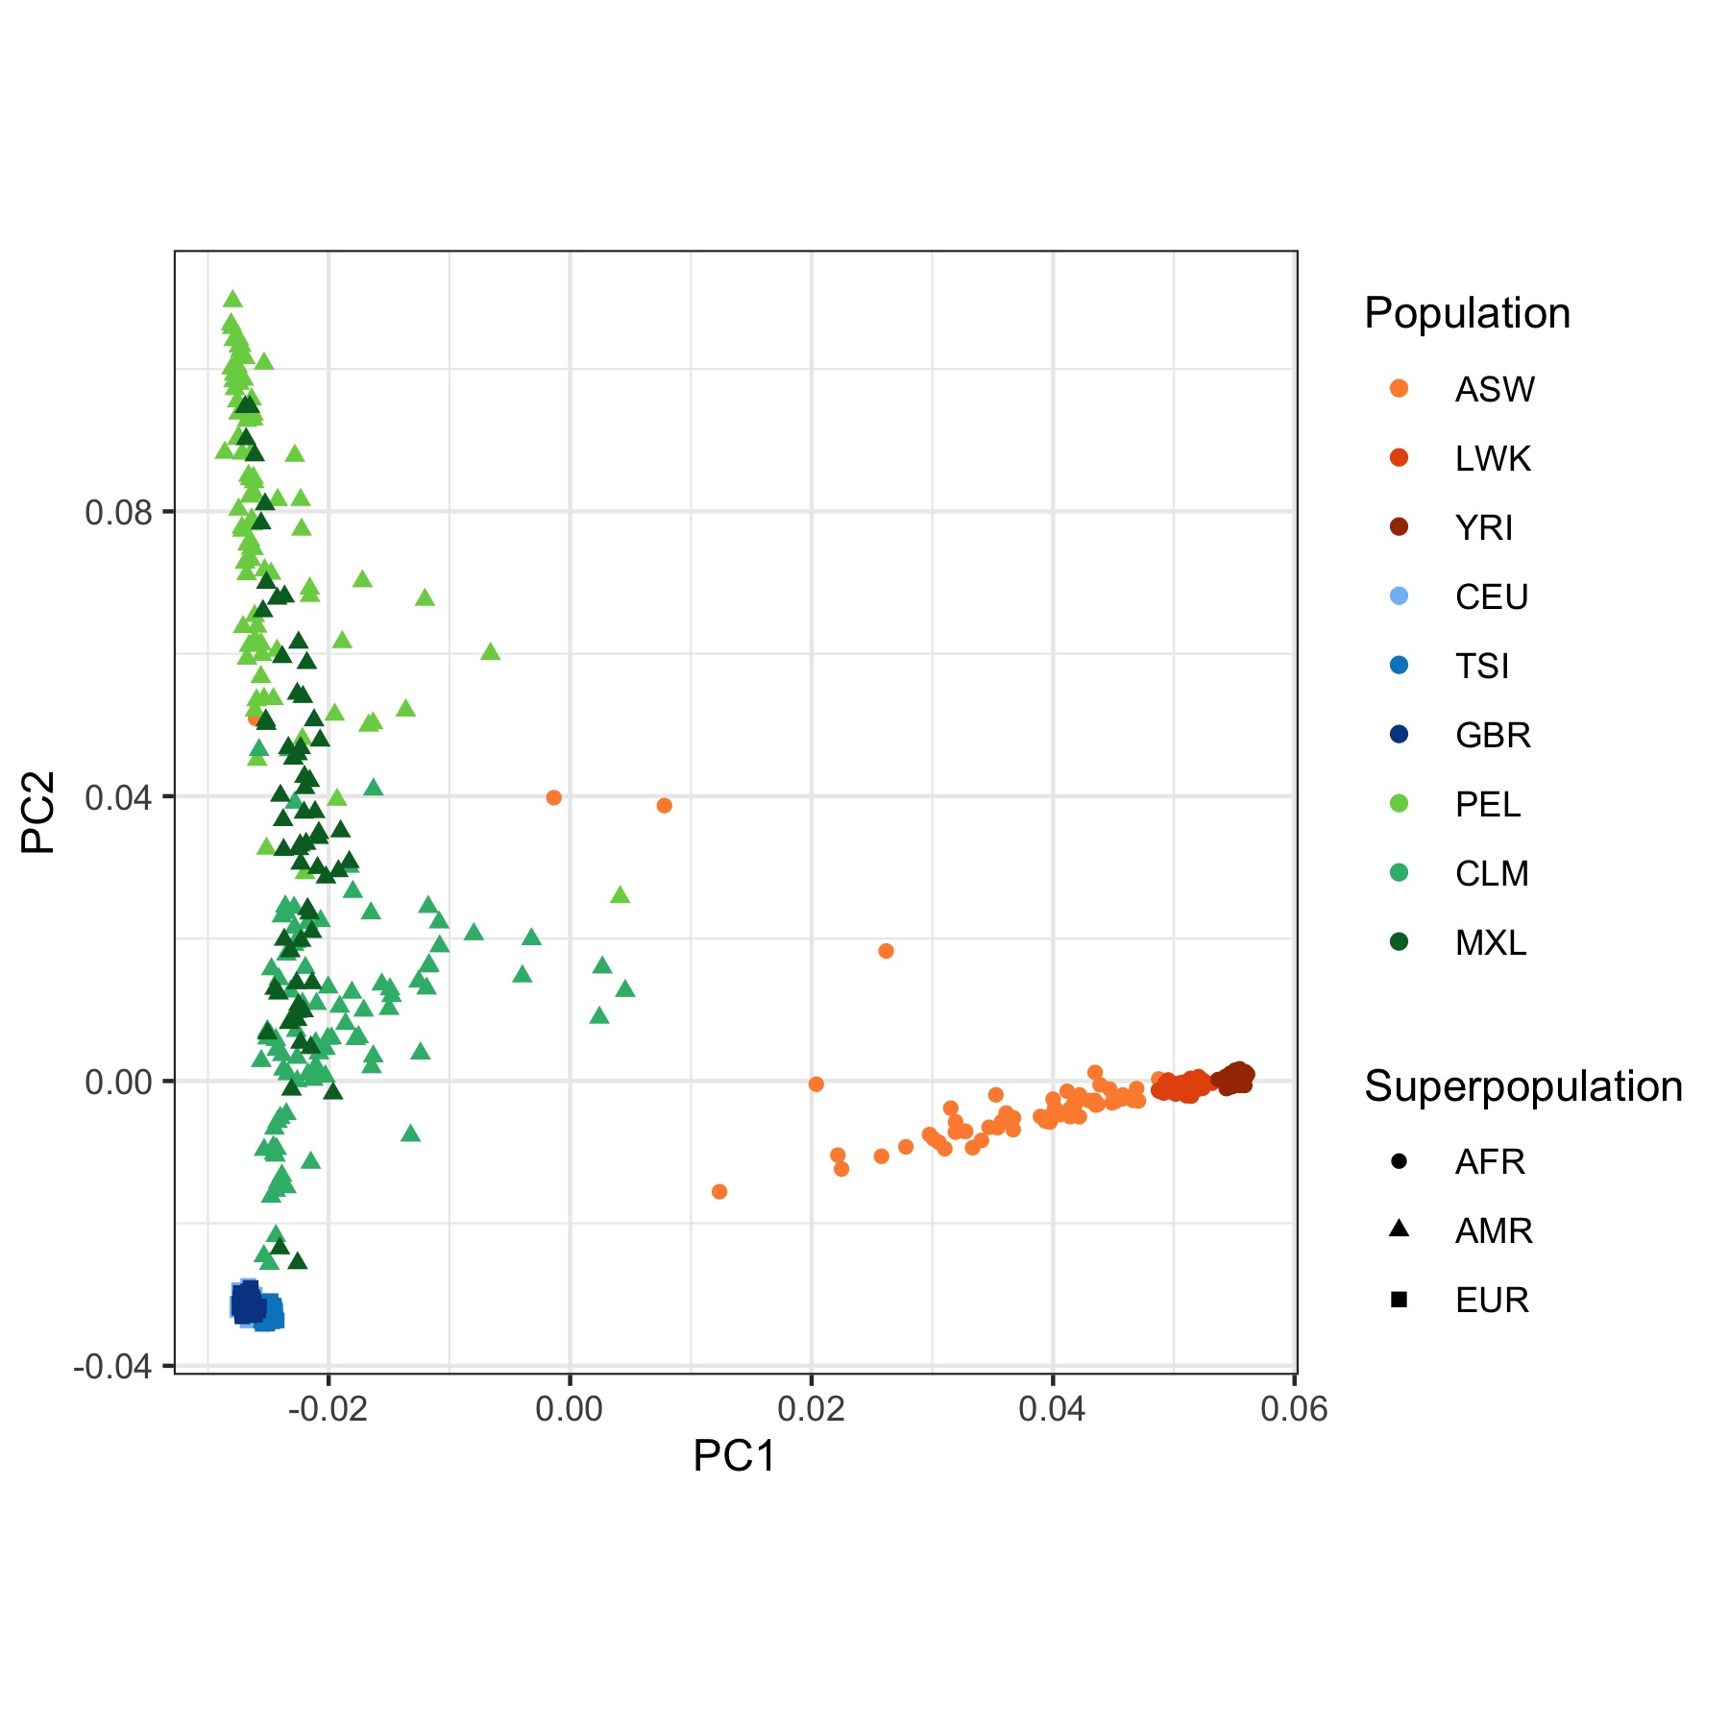
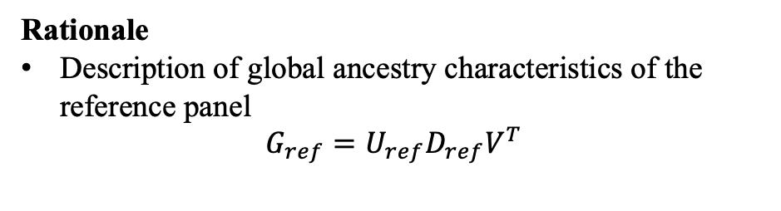
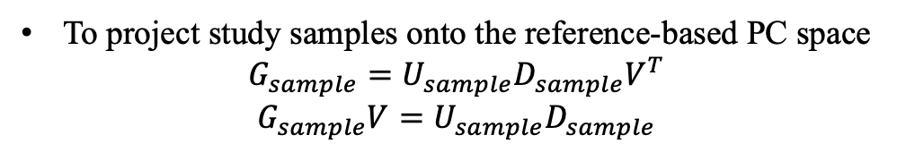
Aim 1: Design continuous local ancestry measure
Rationale
Description of global ancestry characteristics of the reference panel
$G_{ref}=U_{ref}D_{ref}V^{T}$
To project study samples onto the reference-based PC space
$$G_{sample}=U_{sample}D_{sample}V^{T}$$
$G_{sample}V=U_{sample}D_{sample}$
Fig 6. Projection of global ancestry from the reference panel
Fig 7. Projection of global ancestry from the samples
$G_{ref/sample}=reference/sample genotype data, V=SNP loading matrix, ψ=ancestry projection matrix for K ancestry in the top J PCs,$
$W_{g/l}=global/local ancestry proportion estimates of K ancestry for N samples, X_{g/l}=global/local ancestry projection onto the top J PCs$,
$U=ancestral eigenvectors, D=coordinate scaling matrix$

Slide 12
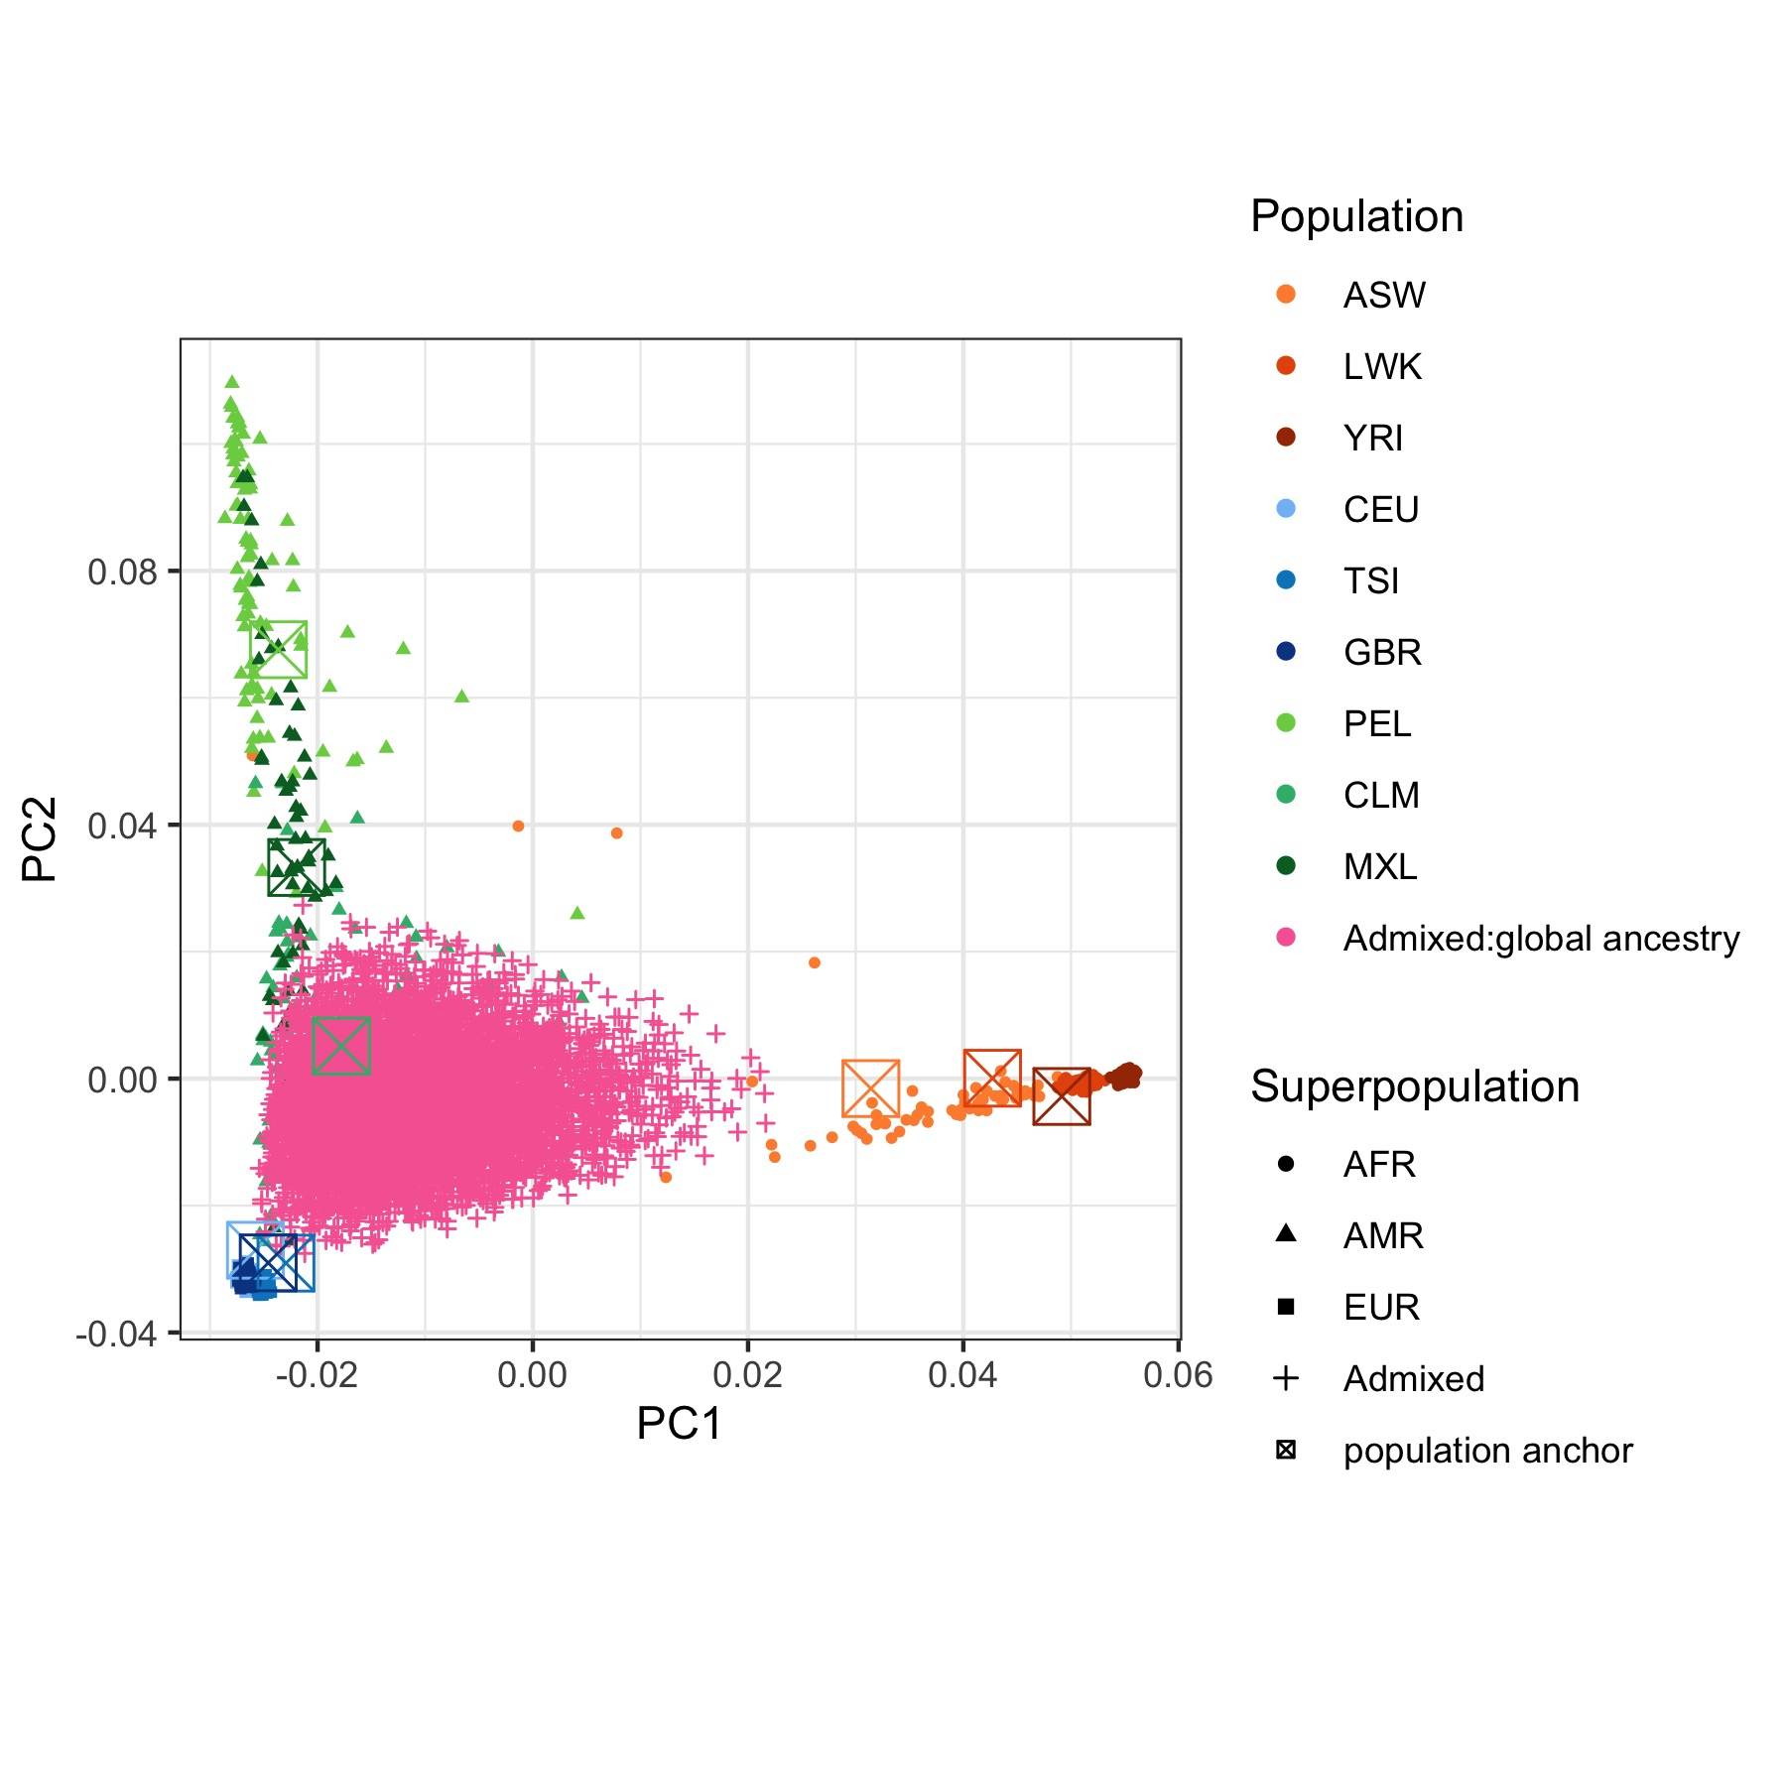
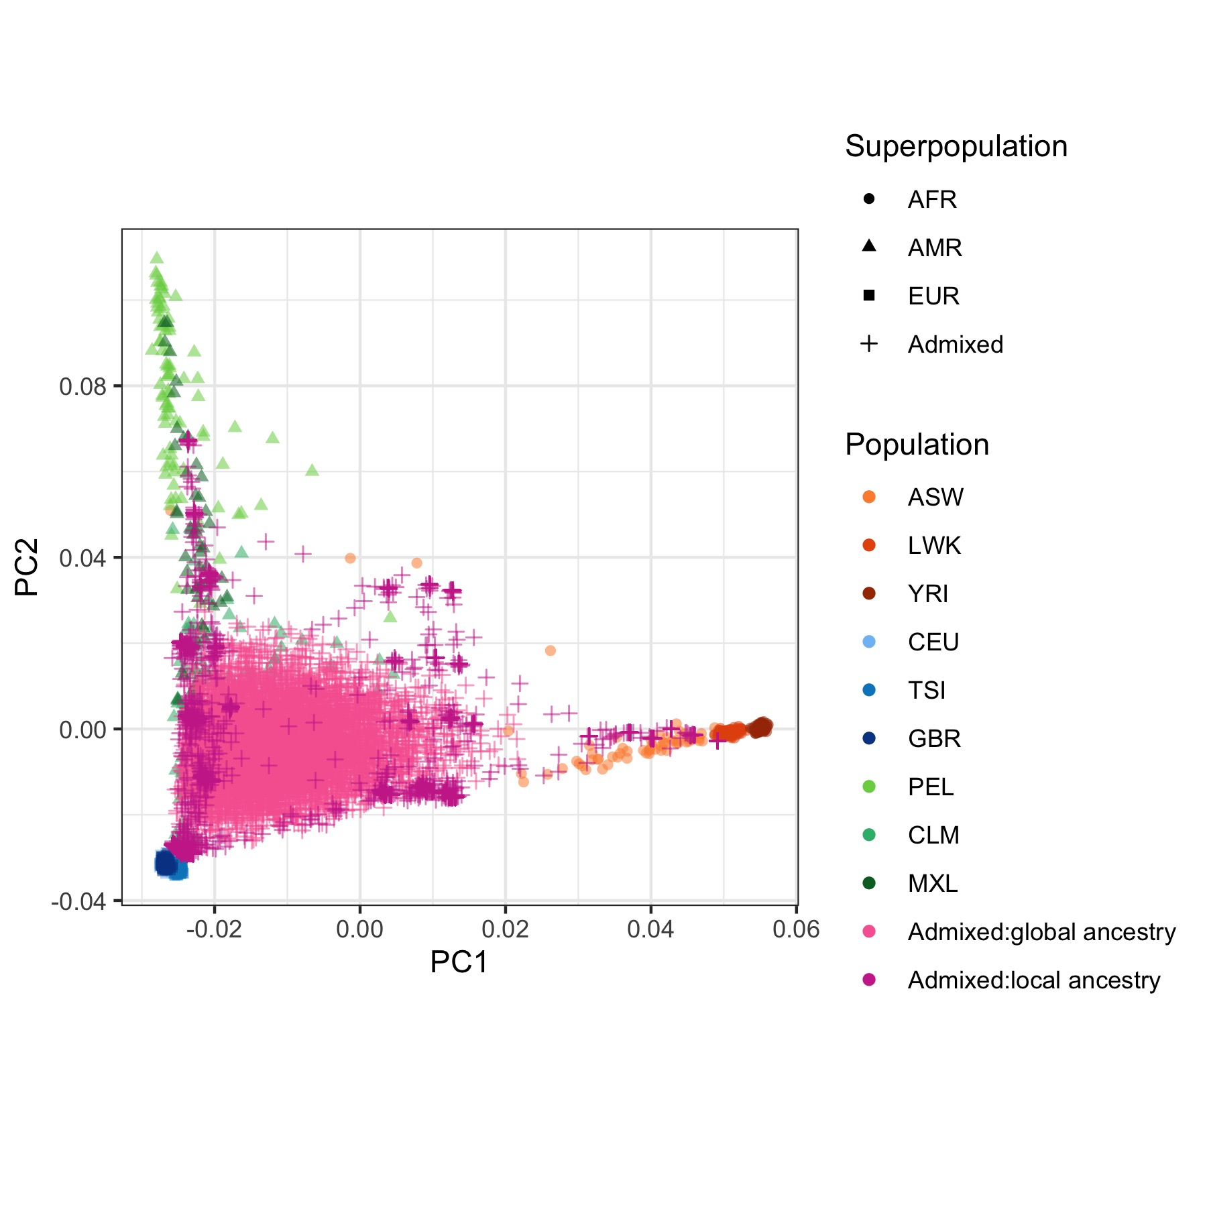
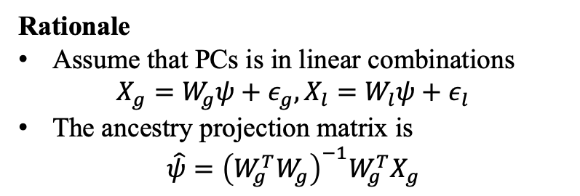
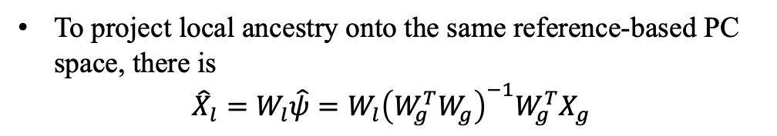
Aim 1: Design continuous local ancestry measure
Rationale
Assume that PCs is in linear combinations
$X_{g}=W_{g}ψ+ε_{g}, X_{l}=W_{l}ψ+ε_{l}$
The ancestry projection matrix is
$\hat{ψ}={\left(W_{g}^{T}W_{g}\right)}^{−1}W_{g}^{T}X_{g}$
To project local ancestry onto the same reference-based PC space, there is
$${\hat{X}}_{l}=W_{l}\hat{ψ}=W_{l}{\left(W_{g}^{T}W_{g}\right)}^{−1}W_{g}^{T}X_{g}$$
Fig 8. Projection of ancestry projection matrix
Fig 9. Projection of local ancestry from samples
$G_{ref/sample}=reference/sample genotype data, V=SNP loading matrix, ψ=ancestry projection matrix for K ancestry in the top J PCs,$
$W_{g/l}=global/local ancestry proportion estimates of K ancestry for N samples, X_{g/l}=global/local ancestry projection onto the top J PCs$,
$U=ancestry centroid, D=coordinate scaling matrix$

Slide 13
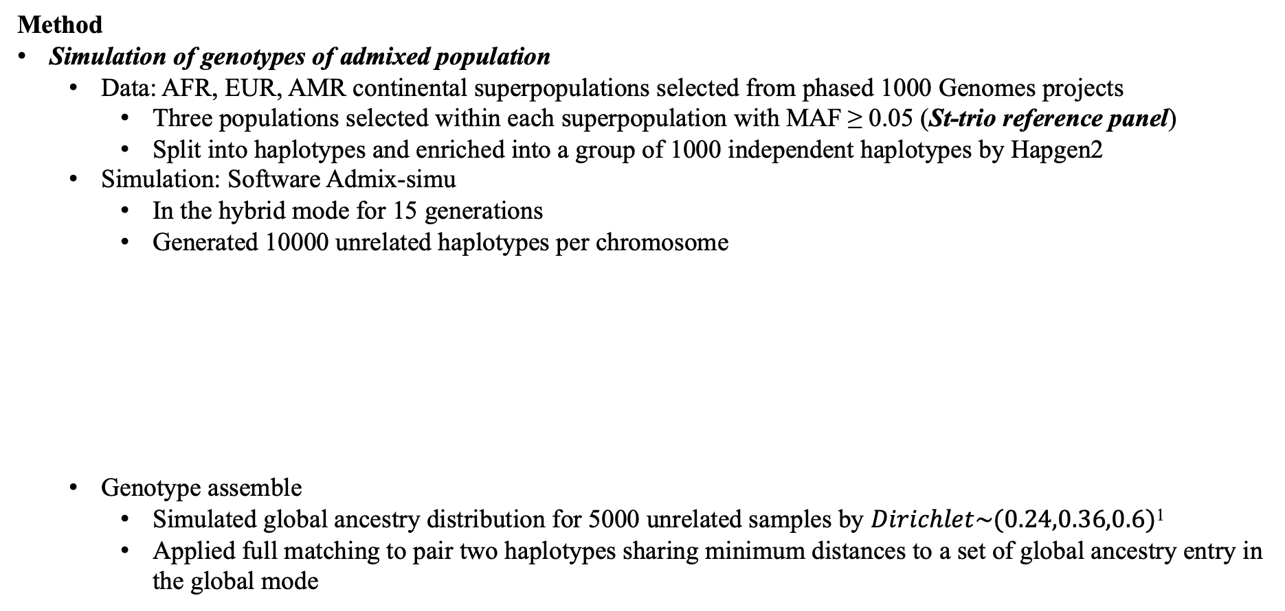
Aim 1: Design continuous local ancestry measure
Method
Simulation of genotypes of admixed population
Data: AFR, EUR, AMR continental superpopulations selected from phased 1000 Genomes projects
Three populations selected within each superpopulation with MAF ≥ 0.05 (St-trio reference panel)
Split into haplotypes and enriched into a group of 1000 independent haplotypes by Hapgen2
Simulation: Software Admix-simu
In the hybrid mode for 15 generations
Generated 10000 unrelated haplotypes per chromosome
Genotype assemble
Simulated global ancestry distribution for 5000 unrelated samples by $Dirichlet\sim (0.24,0.36,0.6)$¹
Applied full matching to pair two haplotypes sharing minimum distances to a set of global ancestry entry in the global mode
Table 5. List of the St-trio reference panel and corresponding admixture proportions
Population | Superpopulation
 | AFR |  |  | EUR |  |  | AMR
 | ASW | LWK | YRI | CEU | TSI | GBR | PEL | CLM | MXL
sample size | 61 | 99 | 108 | 99 | 107 | 91 | 85 | 94 | 64
admixture proportion | 0.066 | 0.066 | 0.066 | 0.166 | 0.166 | 0.167 | 0.101 | 0.101 | 0.101
¹: Raw proportions are Dirichlet(0.2, 0.3, 0.5), converted into Dirichlet(0.24, 0.36, 0.6) to adjust for unsymmetric distribution

Slide 14
Aim 1: Design continuous local ancestry measure
Method
Global and local ancestry inferences
LAI: called by RFMix v1.5.4 with default parameter settings
Simulated two scenarios
Properly inferred: If the reference panel used in local ancestry inference is consistent with genetic ancestral composition (St-trio).
Improperly inferred: manually manipulated reference panel composition
Accuracy of local ancestry inference: the proportion of samples whose local ancestry was accurately inferred weighted by tract lengths
Global ancestry:
Weighted local ancestry according to genomic distances
Further aggregated across the whole genome
Table 6. List of composition of reference panel used for local ancestry inference
population and sample size reference panel |  | AFR |  |  |  | EUR |  |  |  | AMR
 |  | ASW | LWK | YRI | ESN | CEU | TSI | GBR | FIN | PEL | CLM | MXL | PUR
 |  | 61 | 99 | 108 | 99 | 99 | 107 | 91 | 99 | 85 | 94 | 64 | 104
Tr-duo | partially missed |  | X | X |  | X | X |  |  | X |  | X
AMR-free | entirely missed | X | X | X |  | X | X | X
St-trio | Properly inferred | X | X | X |  | X | X | X |  | X | X | X
Ex-quad | excessively added | X | X | X | X | X | X | X | X | X | X | X | X

Slide 15
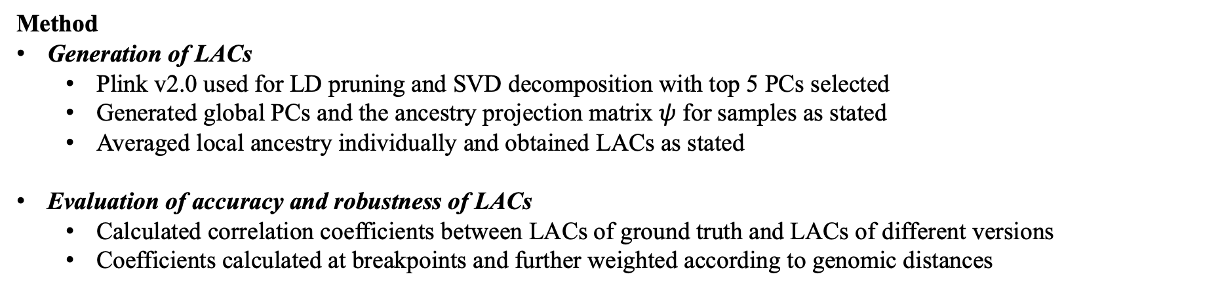
Aim 1: Design continuous local ancestry measure
Method
Generation of LACs
Plink v2.0 used for LD pruning and SVD decomposition with top 5 PCs selected
Generated global PCs and the ancestry projection matrix $ψ$ for samples as stated
Averaged local ancestry individually and obtained LACs as stated
Evaluation of accuracy and robustness of LACs
Calculated correlation coefficients between LACs of ground truth and LACs of different versions
Coefficients calculated at breakpoints and further weighted according to genomic distances
Table 7. List of sources of LACs and corresponding tests
Reference panel |  | Superpopulation |  |  | Type of LACs | Test type
 |  | African | European | Amerindian
Genotype simulation | St-trio | ASW, LWK, YRI | CEU, TSI, GBR | PEL, CLM, MXL | Ground truth | -
Local ancestry inference | Tr-duo | LWK, YRI | CEU, TSI | PEL, MXL | Misclassified | Robustness test
 | AMR-free | ASW, LWK, YRI | CEU, TSI, GBR |  | Misclassified | Robustness test
 | St-trio | ASW, LWK, YRI | CEU, TSI, GBR | PEL, CLM, MXL | Properly inferred | Accuracy test
 | Ex-quad | ASW, LWK, YRI, ESN | CEU, TSI, GBR, FIN | PEL, CLM, MXL, PUR | Misclassified | Robustness test

Slide 16
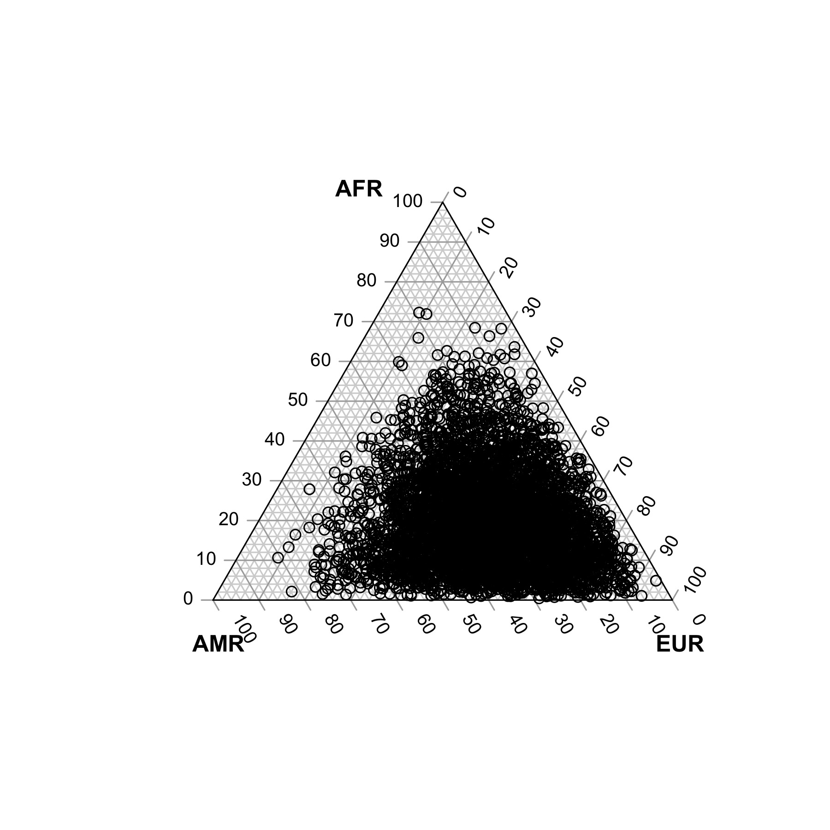
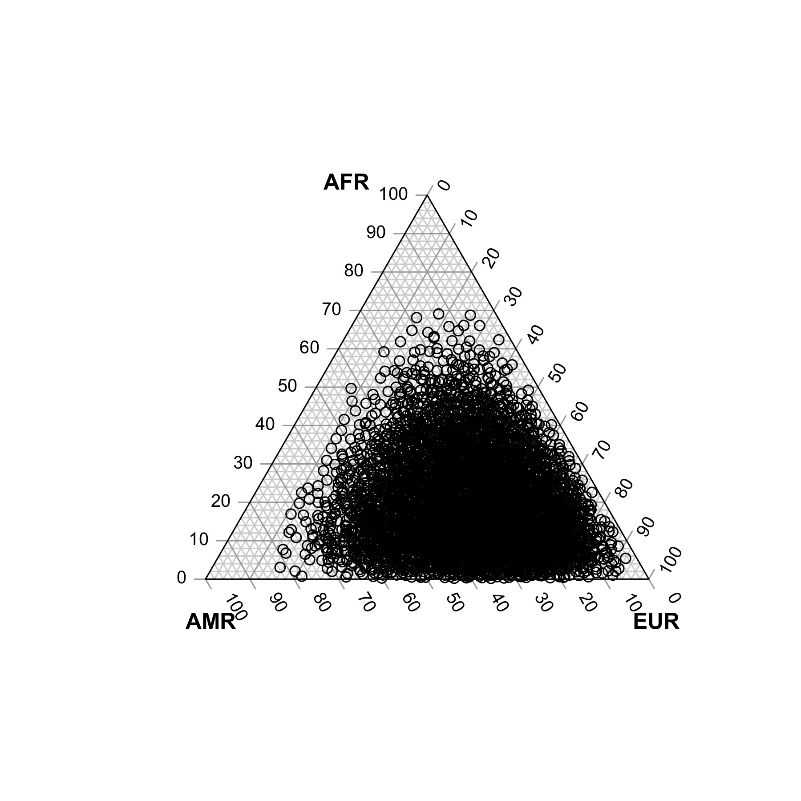
Aim 1: Design continuous local ancestry measure
Results
Simulation of genotypes of admixed populations
7271405 SNPs included
565 admixture events in average observed per sample
1241461 unique breakpoints in total observed across the whole genome
Table 8. Comparison of average continental global ancestry between simulated and matched truth
Type | AFR¹ | EUR¹ | AMR¹
Simulated truth | 0.2016 (0.0067 – 0.6580) | 0.4982 (0.1029 – 0.9004) | 0.3002 (0.0318 – 0.7769)
Matched truth | 0.1971 (0.0018 – 0.6908) | 0.4988 (0.0800 – 0.9205) | 0.304 (0.0155 – 0.8166)
¹: Mean (Min - Max)
a) Simulated continental global ancestry
b) Continental global ancestry of ground truth
Fig 10. Comparison of continental global ancestry distribution

Slide 17

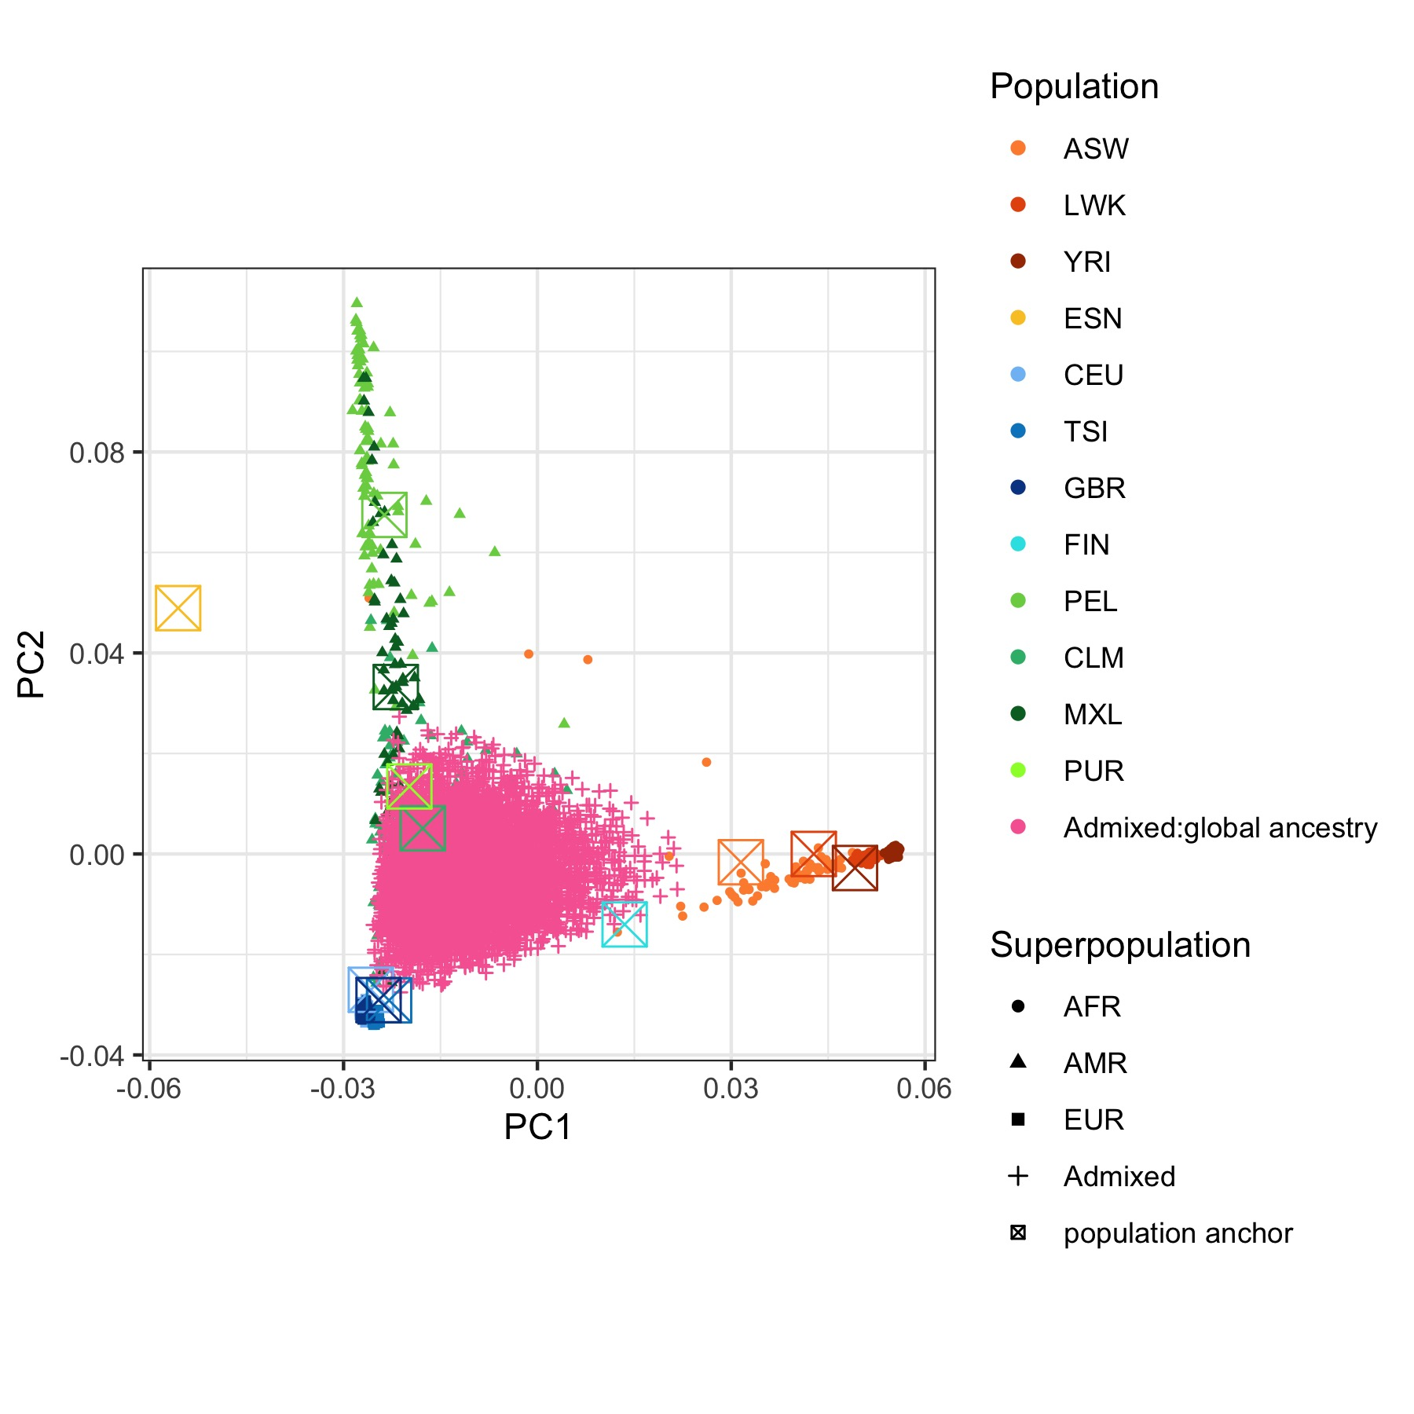

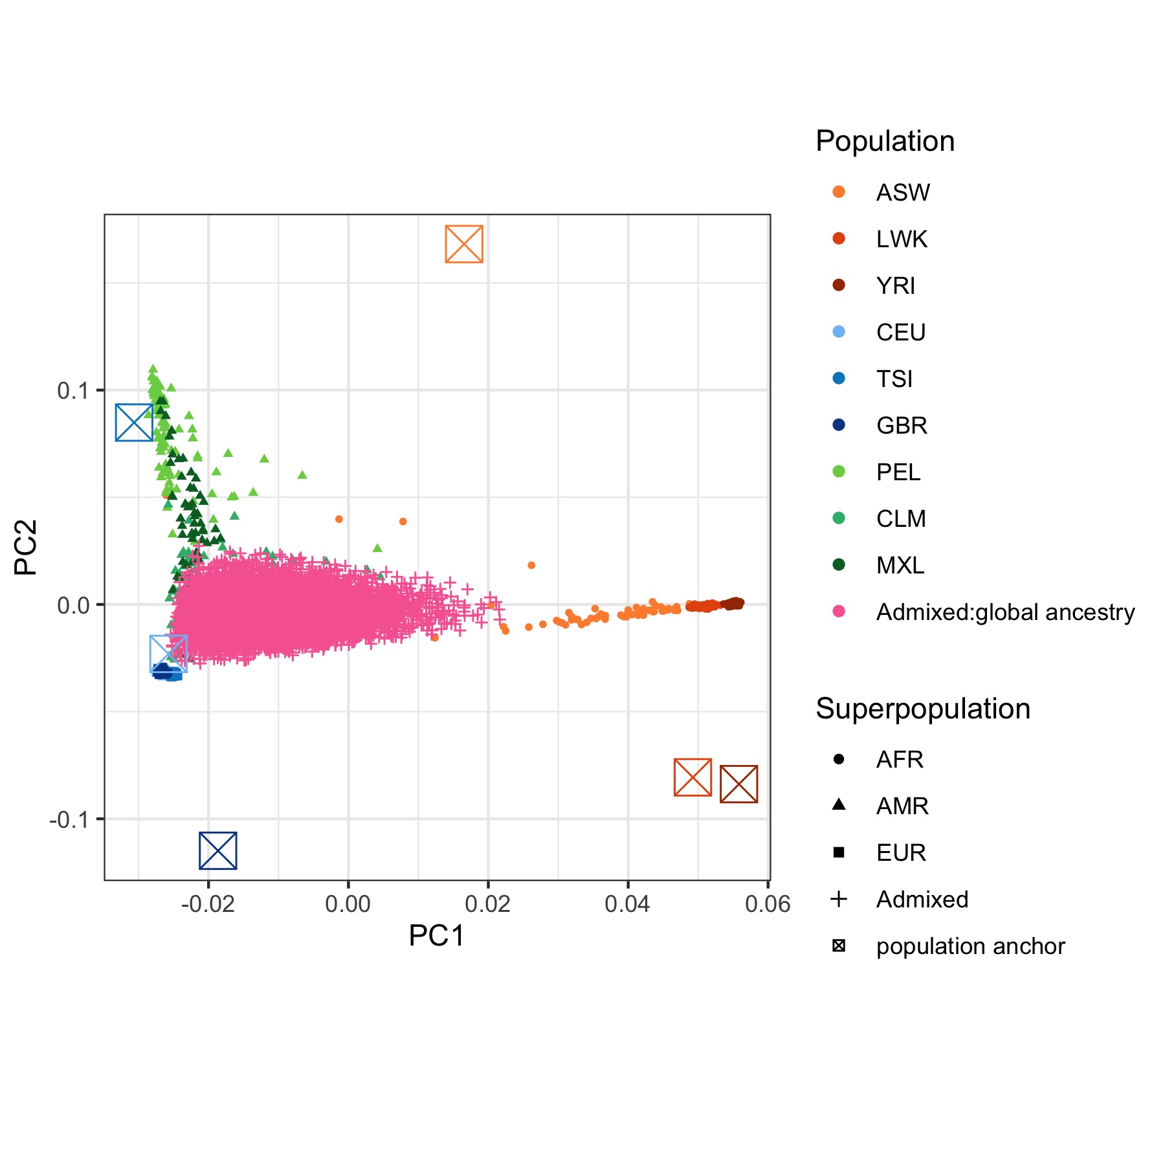
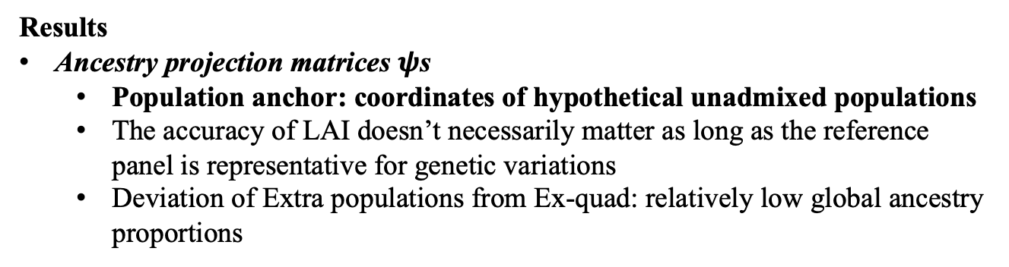
Aim 1: Design continuous local ancestry measure
Results
Ancestry projection matrices $ψ$s
Population anchor: coordinates of hypothetical unadmixed populations
The accuracy of LAI doesn’t necessarily matter as long as the reference panel is representative for genetic variations
Deviation of Extra populations from Ex-quad: relatively low global ancestry proportions
Table 9. Summary of LAI and population anchors
Estimates | Tr-duo | AMR-free | St-trio | Ex-quad
 |  |  |  | Genuine | Extra
LAI accuracy | 0.6489 | 0.6765 | 0.9682 | 0.9687
Were population anchors precisely inferred | X |  | X | X
a) Ground truth
b) Tr-duo
c) AMR-free
d) St-trio
e) Ex-quad
Fig 11. Projection of ancestry projection matrices

Slide 18
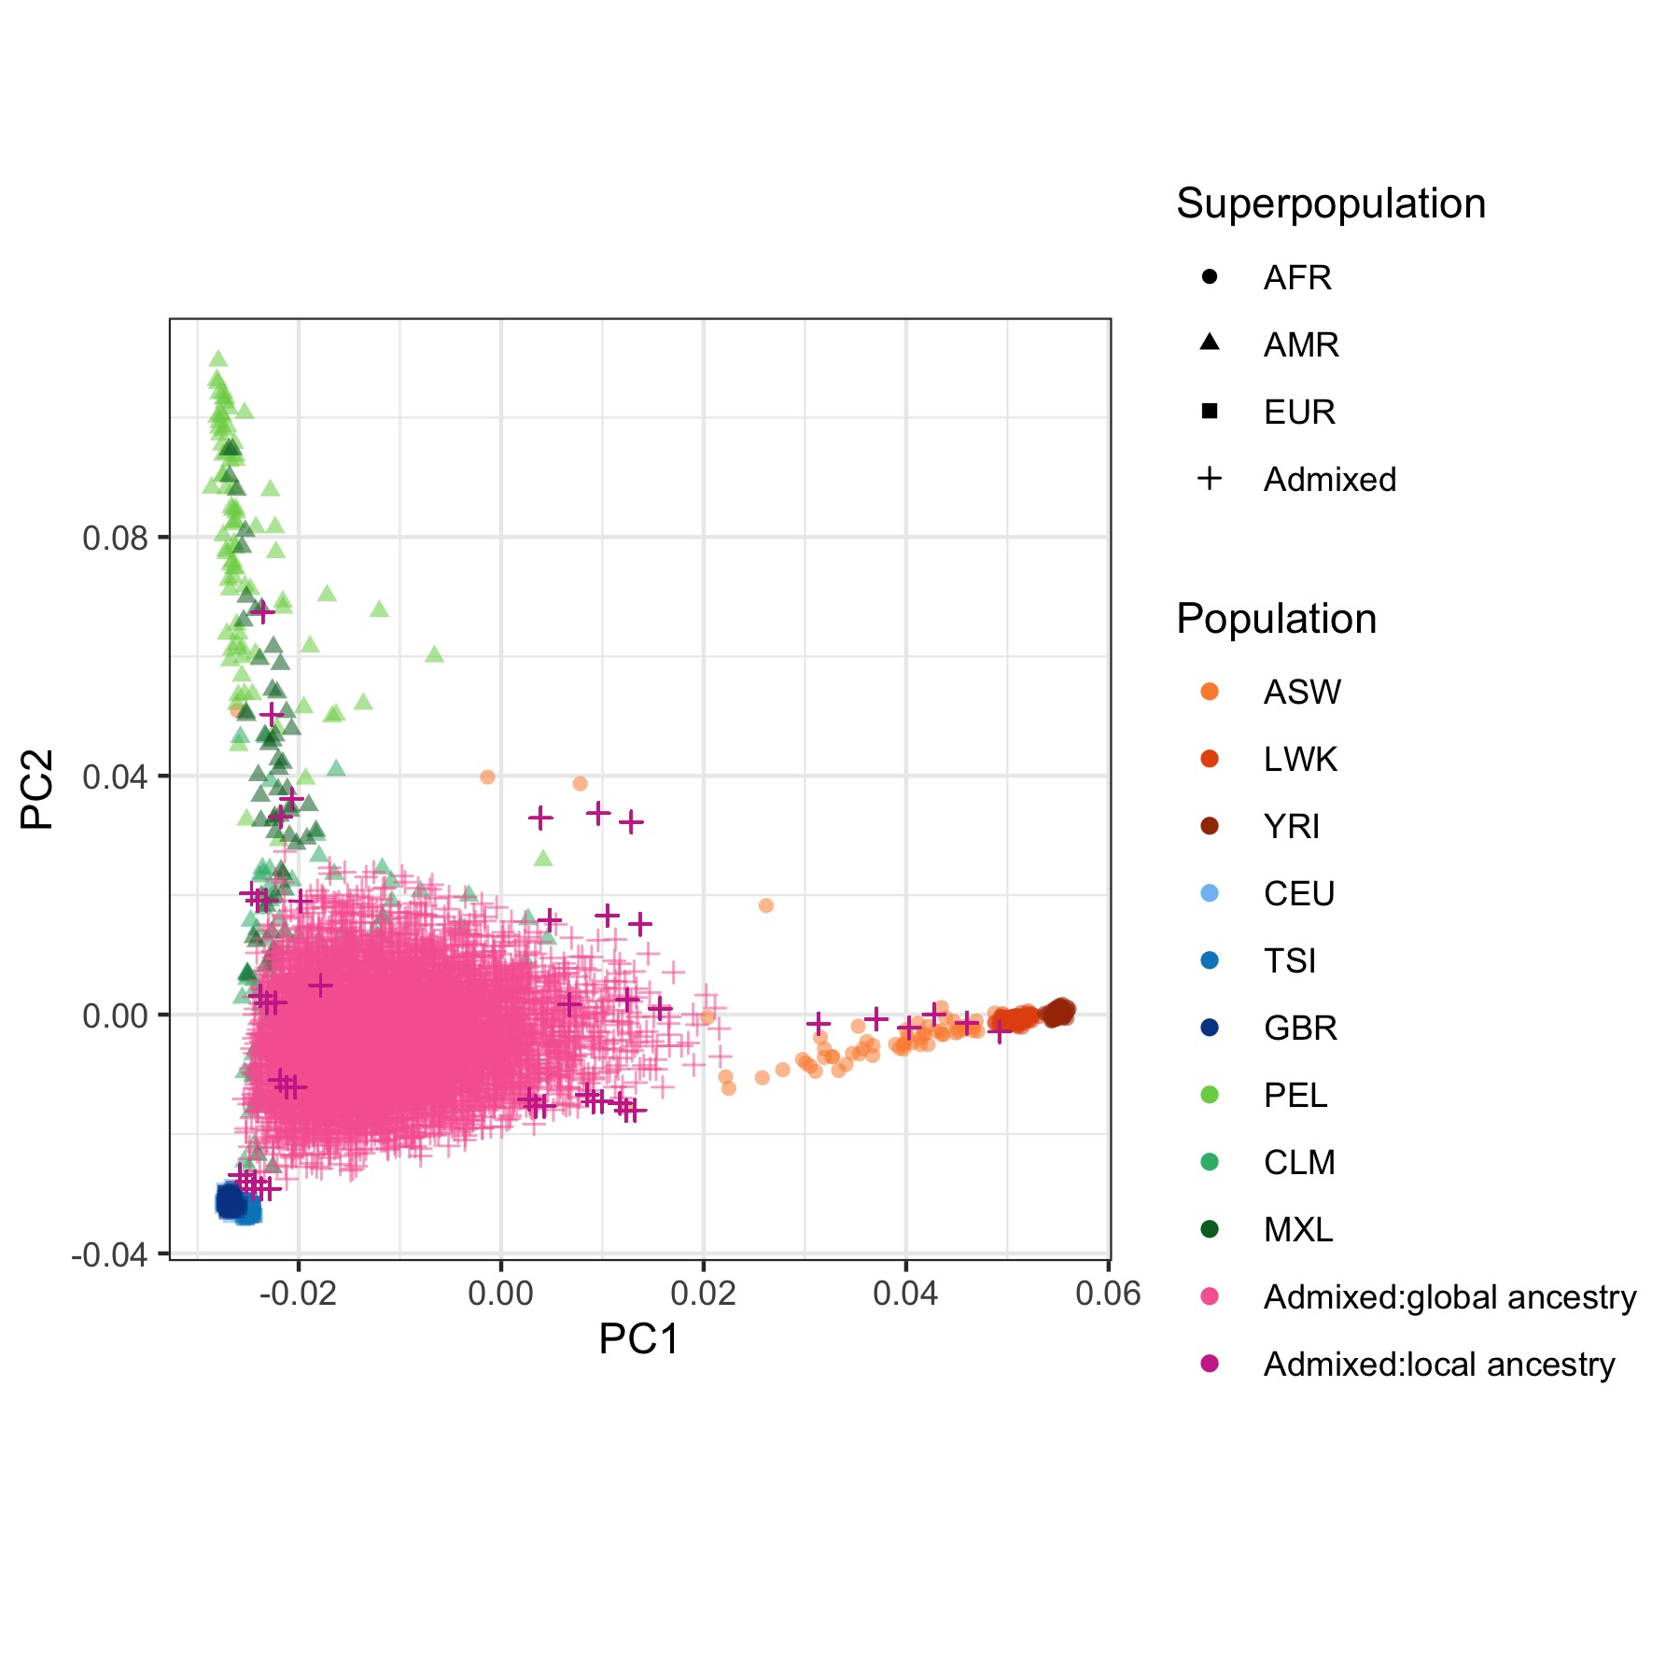
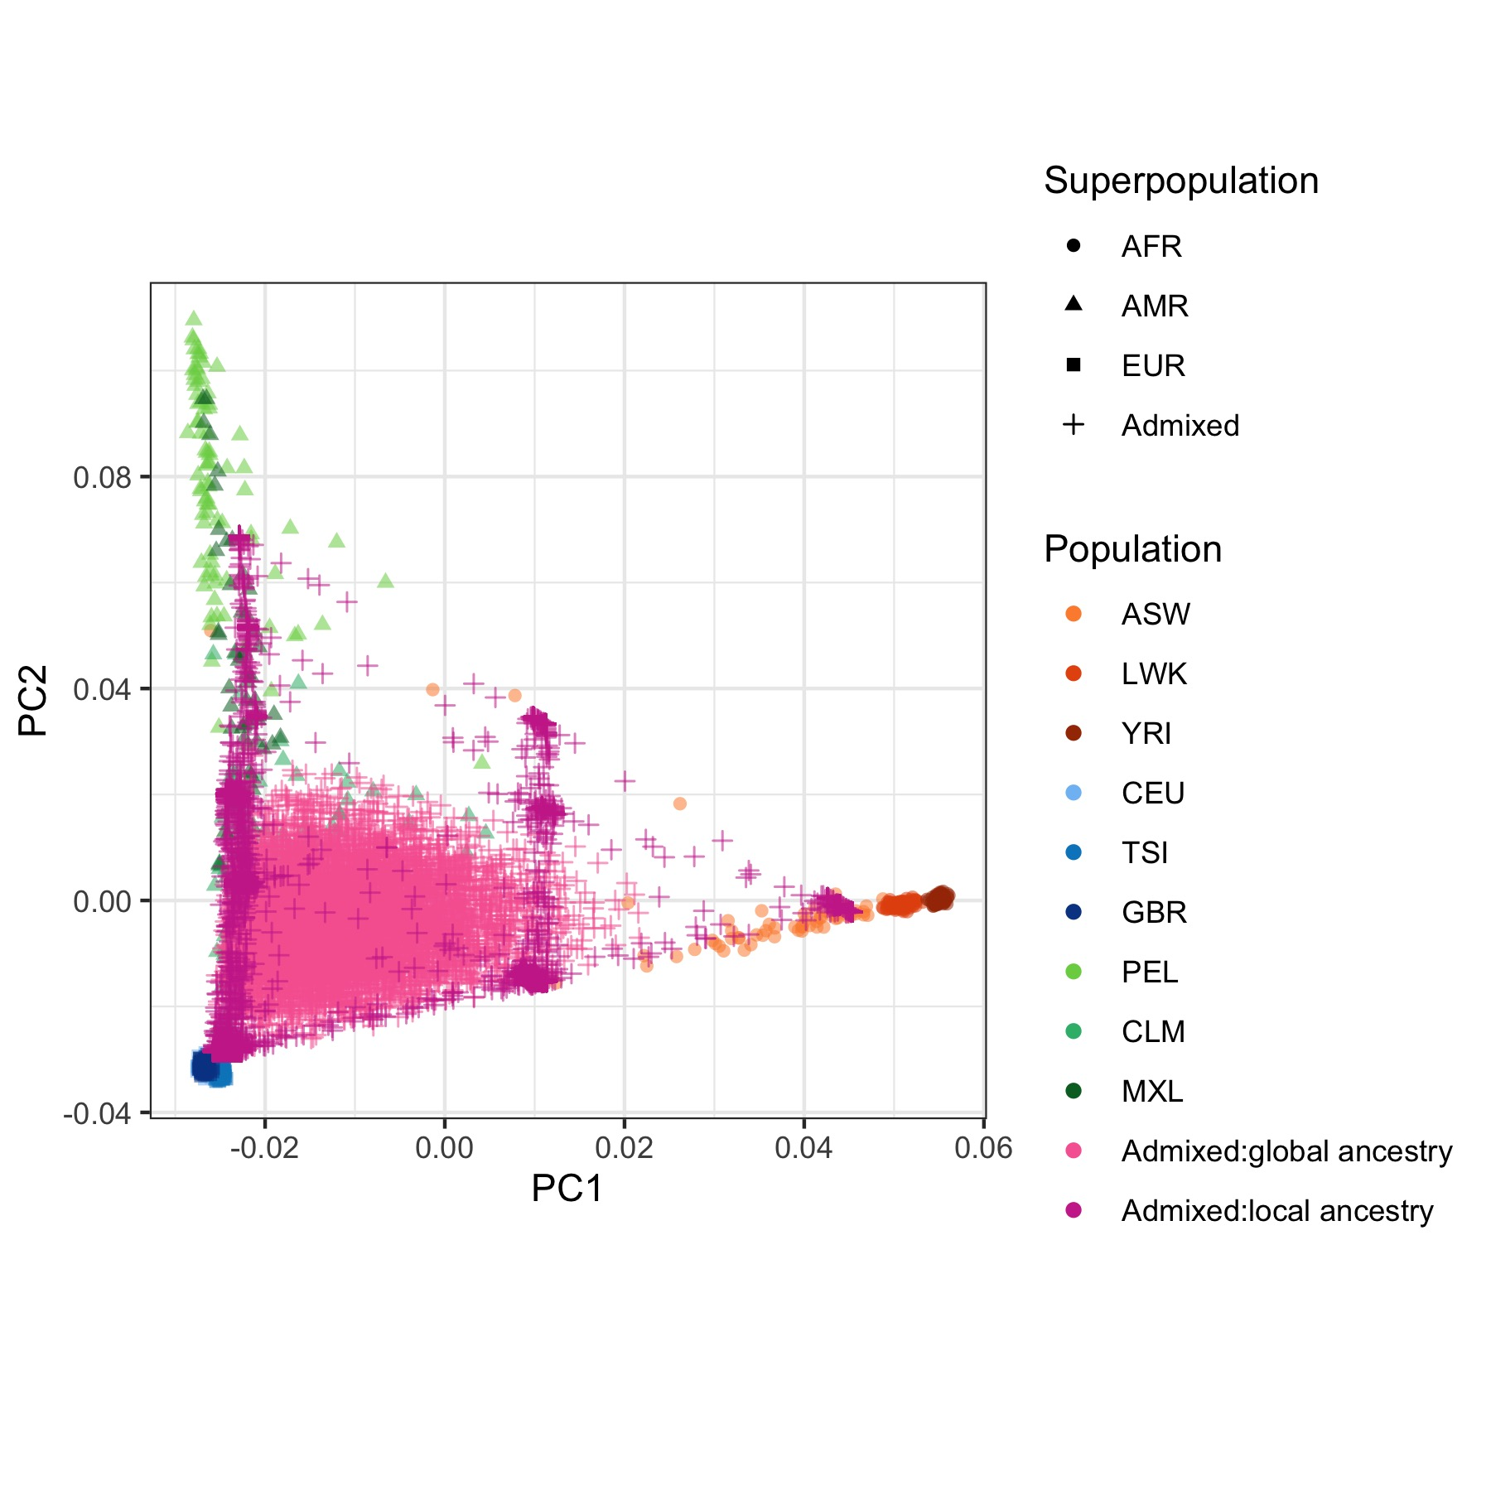
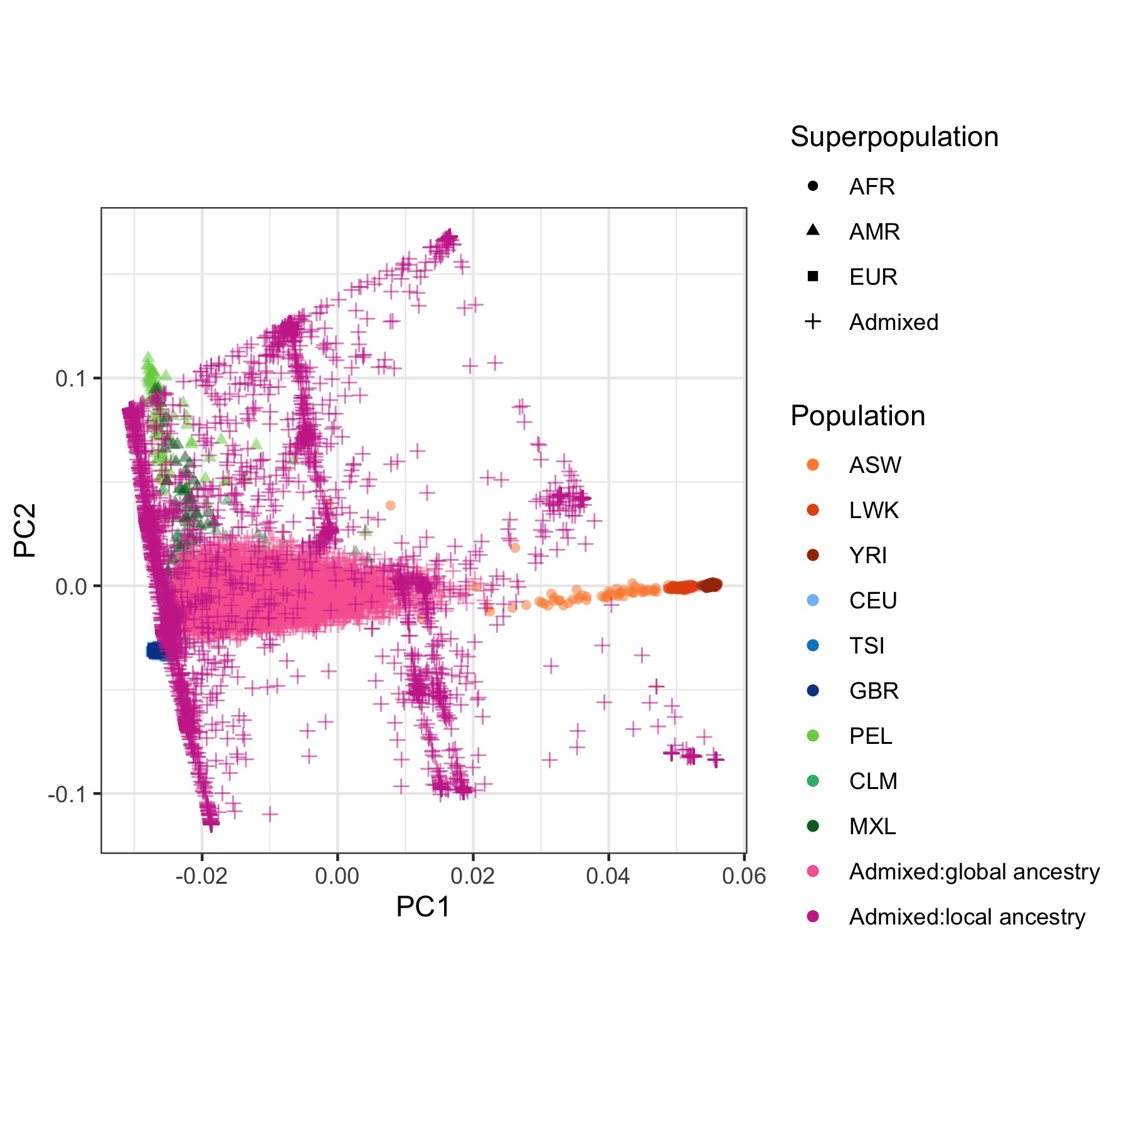

Aim 1: Design continuous local ancestry measure
Results
Local ancestry projection
Deviations between global PCs and LACs if personally highly admixed
Tr-duo LACs: less LAC patterns
AMR-free LACs: mismatched patterns
Ex-quad LACs: didn’t largely affect by extra ancestry components
Table 10. Summary of LAC positions
LAI estimates | Homozygous ancestry | Heterozygous ancestry | Otherwise
 | A = 1, B…I = 0 | A = 0.5, B = 0.5, C..I = 0 | A..I = 0.x
LAC positions | Close to population anchors | Midpoints of population anchors | Fractional distances of population anchors
a) Ground truth
b) Tr-duo
c) AMR-free
d) St-trio
e) Ex-quad
Fig 12. Visualization of the 424th LACs at chr12 (chr12:71743885-71938780)

Slide 19
Aim 1: Design continuous local ancestry measure
Results
Evaluation of accuracy and robustness of LACs
17429 unique breakpoints identified in LAI, and 19002979 tests conducted
Usually consistent and concordant with ground truth
Reductions observed near telomere and centromere regions with lower LAI accuracy and insufficient SNPs
PC1 usually has most associated correlations
Tr-duo LACs: relatively lower correlations in PC4 – PC5 given the incomprehensive reference panel
AMR-free LACs:
A plunge in PC2 due to absence of AMR components
PC1, 3, 4 remained steady
Projection scheme and continuous global PCs-spanned spaces
Ex-quad LACs: didn’t largely affect by extra ancestry components
Table 11. Summary of LACs’ evaluation test
LACs' version | Test type | Correlation coefficients
 |  | PC1¹ | PC2¹ | PC3¹ | PC4¹ | PC5¹
Tr-duo | Robustness test | 0.9530 (0.7909 – 0.9785) | 0.9181 (0.7028 – 0.9520) | 0.8955 (0.6642 – 0.9340) | 0.6702 (0.4333 – 0.7557) | 0.7500 (0.5357 – 0.7991)
AMR-free | Robustness test | 0.9203 (0.7836 – 0.9605) | 0.1785 (-0.1006 – 0.4885) | 0.9570 (0.7443 – 0.9804) | 0.7804 (0.5068 – 0.8370) | 0.4657 (0.3017 – 0.5557)
St-trio | Accuracy test | 0.9905 (0.8230 – 0.9989) | 0.9828 (0.7607 – 0.9962) | 0.9859 (0.7483 – 0.9984) | 0.9734 (0.6504 – 0.9930) | 0.9748 (0.6860 – 0.9933)
Ex-quad | Robustness test | 0.9898 (0.8162 – 0.9992) | 0.9829 (0.7554 – 0.9966) | 0.9823 (0.6491 – 0.9973) | 0.9727 (0.6250 – 0.9940) | 0.9739 (0.6793 – 0.9940)
¹: Mean (Min - Max)

Slide 20
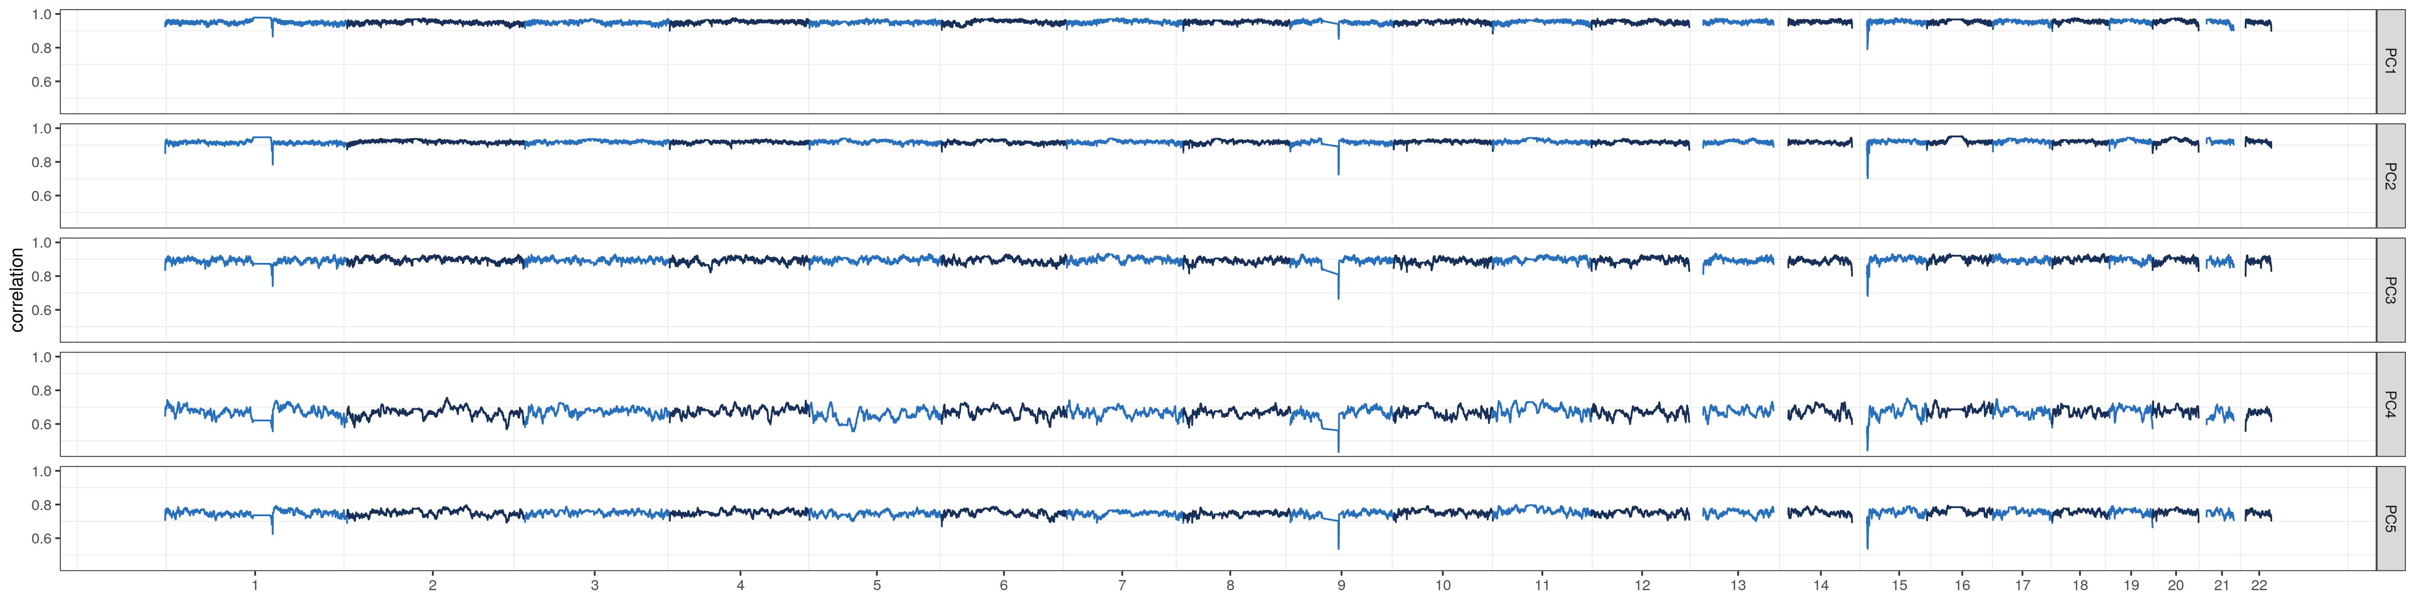
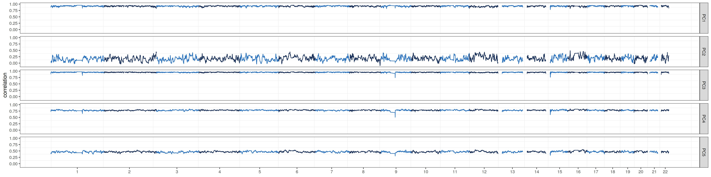
Aim 1: Design continuous local ancestry measure
Results
Evaluation of accuracy and robustness of LACs
a) Tr-duo
b) AMR-free
Fig 13. Correlation-based Manhattan plots across the thole genome

Slide 21
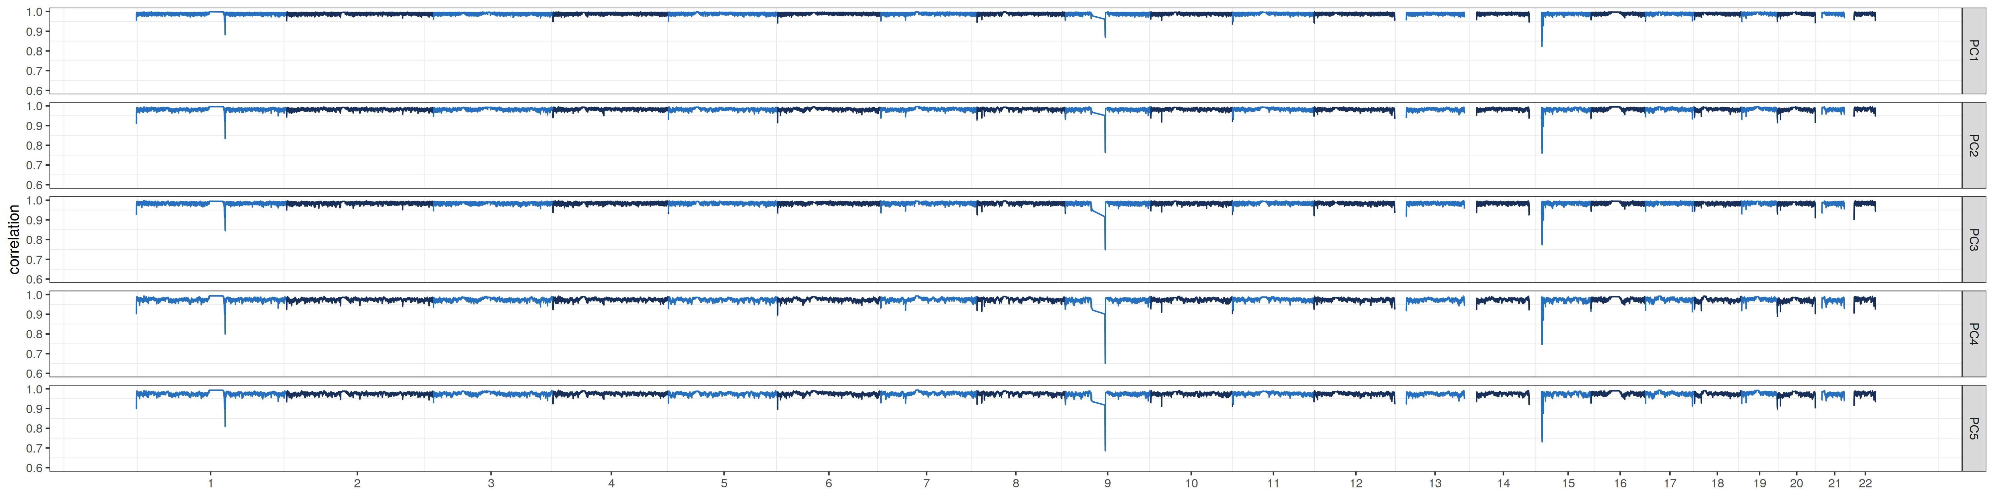
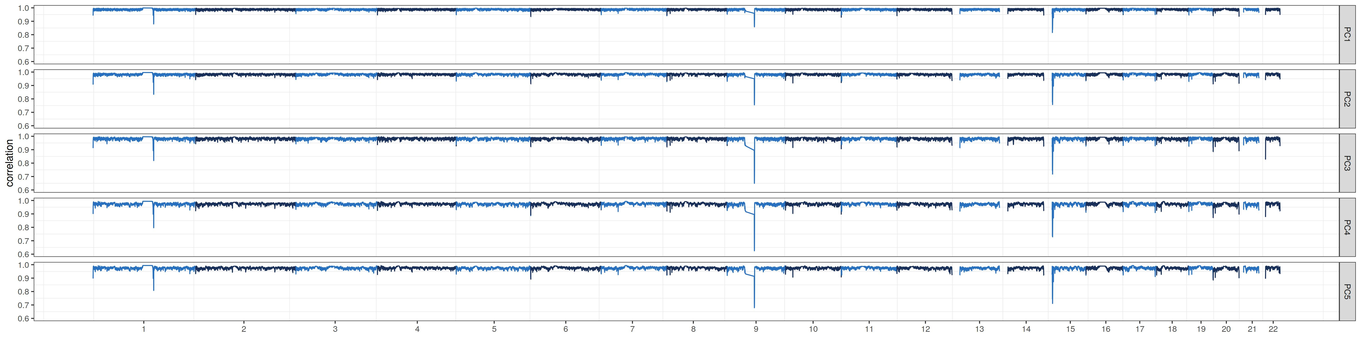
Aim 1: Design continuous local ancestry measure
Results
Evaluation of accuracy and robustness of LACs
c) St-trio
d) Ex-quad
Fig 13. Correlation-based Manhattan plots across the thole genome

Slide 22
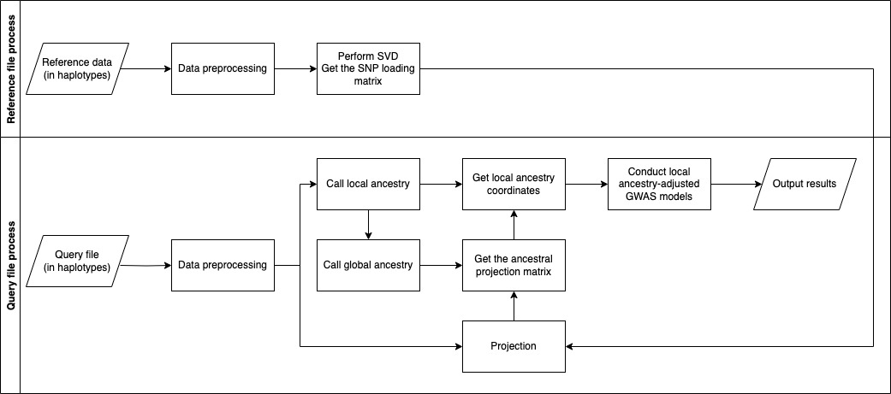
Aim 2: Develop local-ancestry-aware GWAS models
Core ideas
LOCATOR (Local ancestry adjusted GWAS models)
Adapted from Generalized Linear Mixed Model (GLMM)
Applicable for both quantitative and binary traits, related and unrelated populations, etc.
Reduce to linear/Logistic regression for unrelated individuals
Fit a null model that does not include local ancestry effects nor allelic effects as baseline
Approximate allelic effects while project out population stratification effects onto the null model space
Calculation boosting techniques adapted from GMMAT (Chen, et al. 2016), SMMAT (Chen, et al. 2019) and MAGEE (Wang, et al. 2020)
Fig 14. Workflow overview of LOCATOR

Slide 23
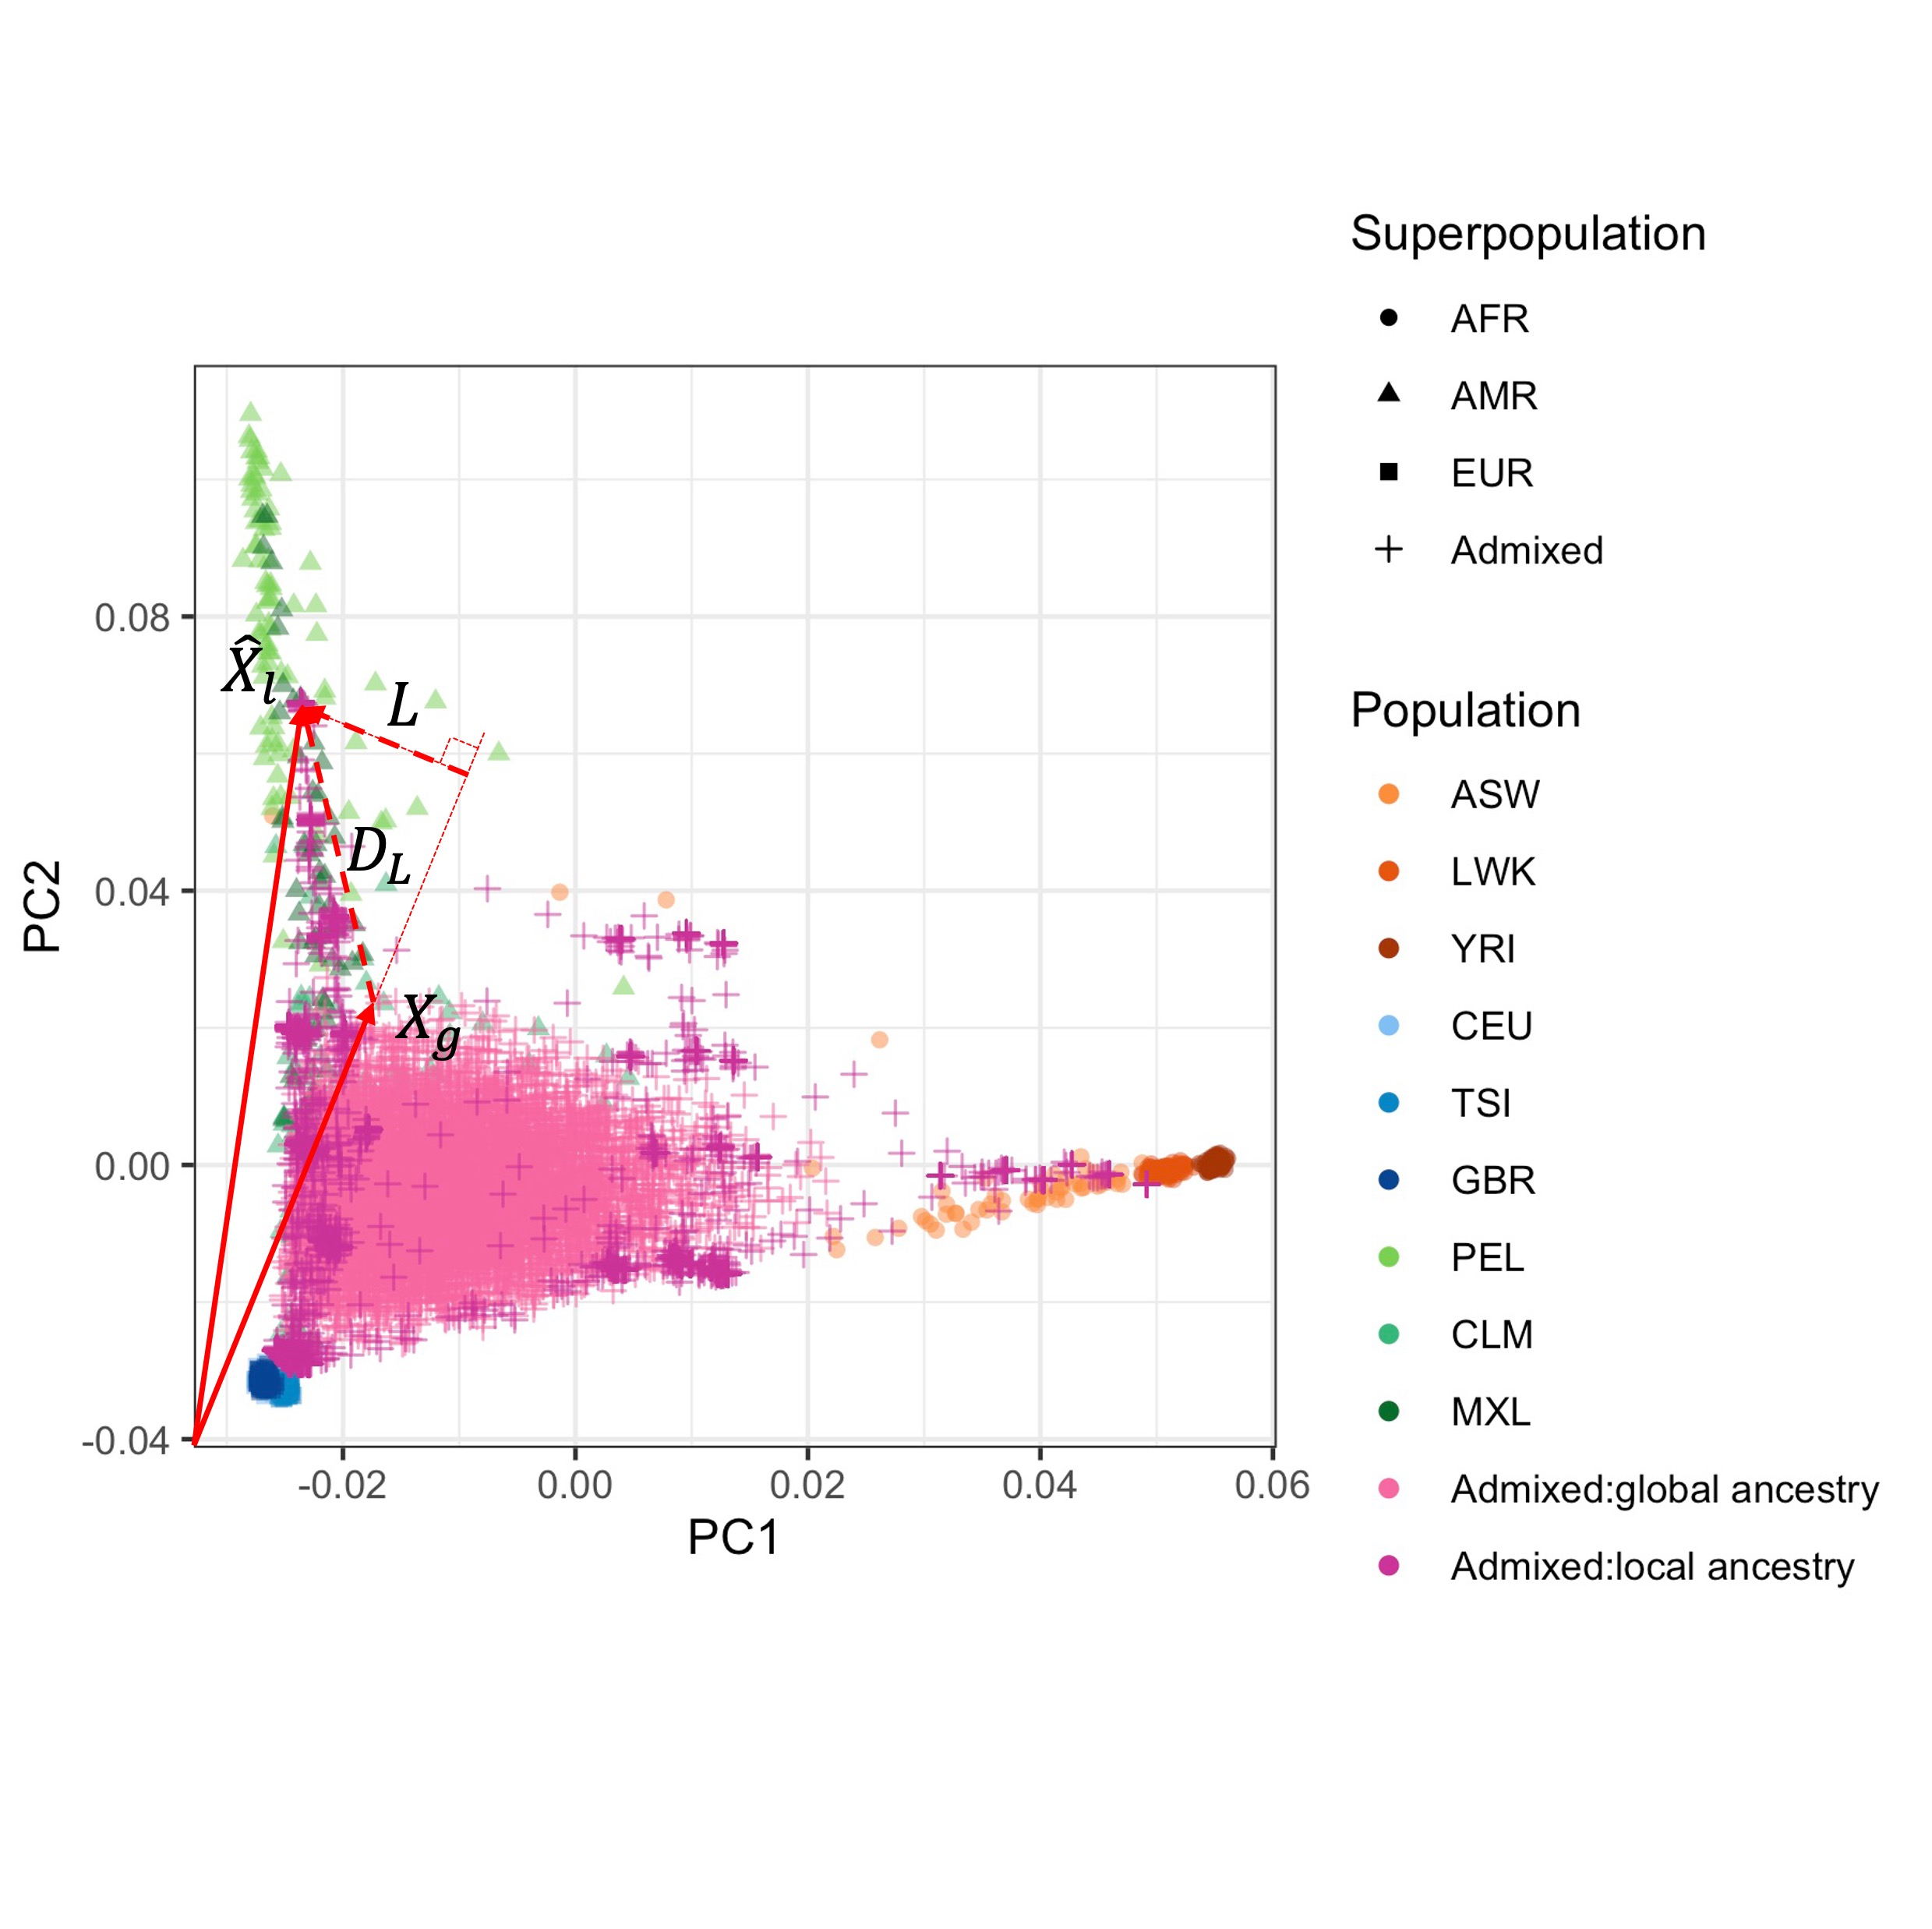
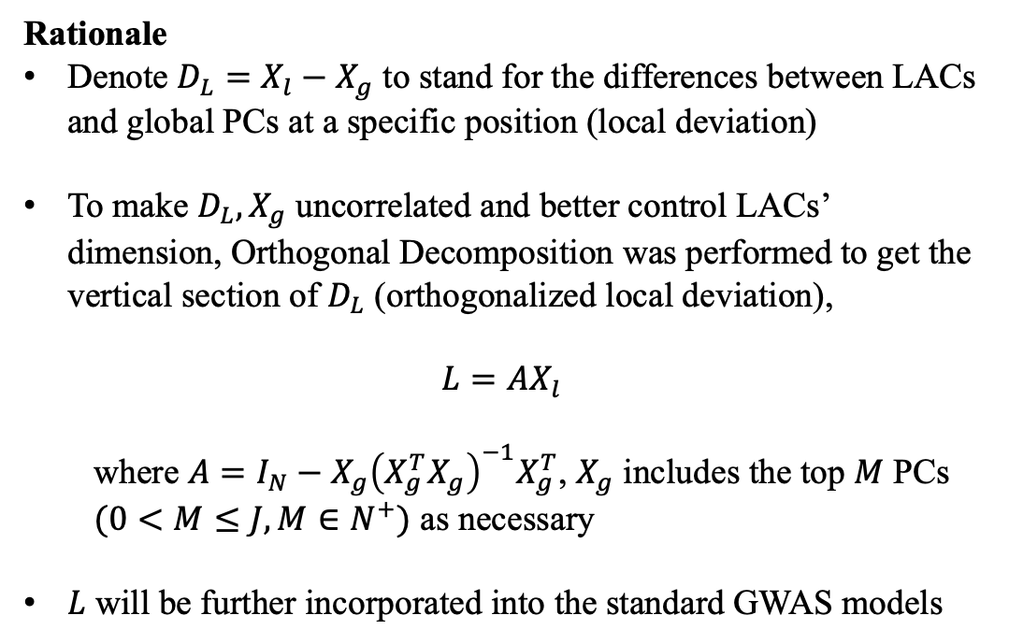
Aim 2: Develop local-ancestry-aware GWAS models
Rationale
Denote $D_{L}=X_{l}−X_{g}$ to stand for the differences between LACs and global PCs at a specific position (local deviation)
To make $D_{L},X_{g}$ uncorrelated and better control LACs’ dimension, Orthogonal Decomposition was performed to get the vertical section of $D_{L}$ (orthogonalized local deviation),
$$L=AX_{l}$$
where $A=I_{N}−X_{g}{\left(X_{g}^{T}X_{g}\right)}^{−1}X_{g}^{T}$, $X_{g}$ includes the top $M$ PCs $(0<M≤J, M∈N^{+})$ as necessary
$L$ will be further incorporated into the standard GWAS models
Fig 15. Orthogonalized local deviation
$X_{g/l}=global/local ancestry coordinateswith the top J PCs for N samples, D_{L}=local deviation at a specific position, L=Orthogonalized local deviation, A=linear annihalating matrix$

Slide 24
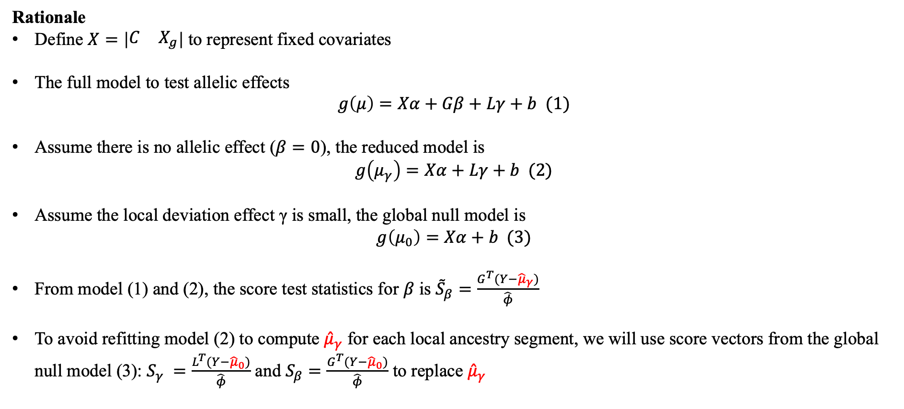
Aim 2: Develop local-ancestry-aware GWAS models
Rationale
Define $X=\left|\begin{matrix}C & X_{g}\end{matrix}\right|$ to represent fixed covariates
The full model to test allelic effects
$$g\left(μ\right)=Xα+Gβ+Lγ+b (1)$$
Assume there is no allelic effect ($β=0$), the reduced model is
$$g\left(μ_{γ}\right)=Xα+Lγ+b (2)$$
Assume the local deviation effect γ is small, the global null model is
$g\left(μ_{0}\right)=Xα+b (3)$
From model (1) and (2), the score test statistics for $β$ is ${\tilde{S}}_{β}=\frac{G^{T}(Y−{\hat{μ}}_{γ})}{\hat{φ}}$
To avoid refitting model (2) to compute ${\hat{μ}}_{γ}$ for each local ancestry segment, we will use score vectors from the global null model (3): $S_{γ} =\frac{L^{T}(Y−{\hat{μ}}_{0})}{\hat{φ}}$ and $S_{β}=\frac{G^{T}(Y−{\hat{μ}}_{0})}{\hat{φ}}$ to replace ${\hat{μ}}_{γ}$
$X_{g/l}=global/local ancestry coordinateswith the top J PCs , b=random effect accounting for sample relatedness, C=covariates, G=genotype vector, Y=phenotype vector,g\left(∙\right)=link function, μ=conditional expectation of Y under different situations, φ=dispersion parameter$

Slide 25
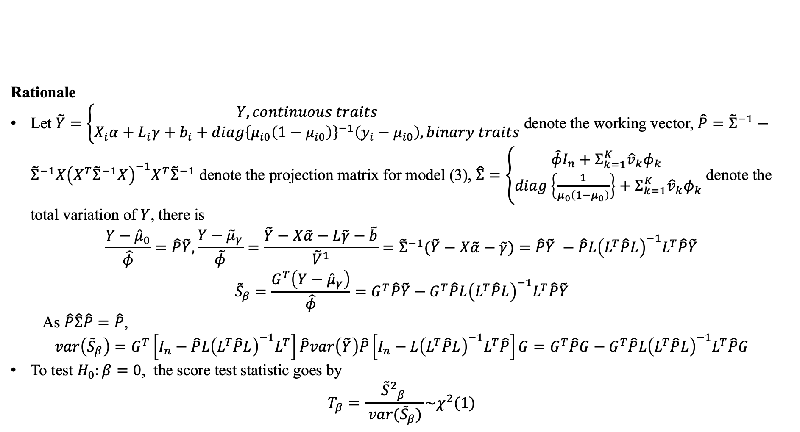
Aim 2: Develop local-ancestry-aware GWAS models
Rationale
Let $\tilde{Y}=\left\{\begin{aligned}Y, continuous traits \\ X_{i}α+L_{i}γ+b_{i}+diag{\left\{μ_{i0}\left(1−μ_{i0}\right)\right\}}^{−1}\left(y_{i}−μ_{i0}\right),binary traits\end{aligned}\right.$ denote the working vector, $\hat{P}={\tilde{Σ}}^{−1}−{\tilde{Σ}}^{−1}X{\left(X^{T}{\tilde{Σ}}^{−1}X\right)}^{−1}X^{T}{\tilde{Σ}}^{−1}$ denote the projection matrix for model (3), $\hat{Σ}=\left\{\begin{aligned}\hat{φ}I_{n}+Σ_{k=1}^{K}{\hat{v}}_{k}φ_{k} \\ diag\left\{\frac{1}{μ_{0}\left(1−μ_{0}\right)}\right\}+Σ_{k=1}^{K}{\hat{v}}_{k}φ_{k}\end{aligned}\right.$ denote the total variation of $Y$, there is
$$\frac{Y−{\hat{μ}}_{0}}{\hat{φ}}=\hat{P}\tilde{Y}, \frac{Y−{\tilde{μ}}_{γ}}{\tilde{φ}}=\frac{\tilde{Y}−X\tilde{α}−L\tilde{γ}−\tilde{b}}{{\tilde{V}}^{1}}={\tilde{Σ}}^{−1}(\tilde{Y}−X\tilde{α}−\tilde{γ})=\hat{P}\tilde{Y} −\hat{P}L{\left(L^{T}\hat{P}L\right)}^{−1}L^{T}\hat{P}\tilde{Y}$$
$${\tilde{S}}_{β}=\frac{G^{T}\left(Y−{\hat{μ}}_{γ}\right)}{\hat{φ}}=G^{T}\hat{P}\tilde{Y}−G^{T}\hat{P}L{\left(L^{T}\hat{P}L\right)}^{−1}L^{T}\hat{P}\tilde{Y}$$
As $\hat{P}\hat{Σ}\hat{P}=\hat{P}$,
$$var\left({\tilde{S}}_{β}\right)=G^{T}\left[I_{n}−\hat{P}L{\left(L^{T}\hat{P}L\right)}^{−1}L^{T}\right]\hat{P}var\left(\tilde{Y}\right)\hat{P}\left[I_{n}−L{\left(L^{T}\hat{P}L\right)}^{−1}L^{T}\hat{P}\right]G=G^{T}\hat{P}G−G^{T}\hat{P}L{\left(L^{T}\hat{P}L\right)}^{−1}L^{T}\hat{P}G$$
To test $H_{0}:β=0$, the score test statistic goes by
$$T_{β}=\frac{{{\tilde{S}}^{2}}_{β}}{ var({\tilde{S}}_{β})}\sim χ^{2}(1)$$
$X_{g/l}=global/local ancestry coordinateswith the top J PCs , b=random effect accounting for sample relatedness, C=covariates, G=genotype vector, Y=phenotype vector,g\left(∙\right)=link function, μ=conditional expectation of Y under different situations, φ=dispersion parameter, V=fixed phenotypic covariances$
¹: random effects b replaced by the BLUP estimator from linear mixed models
Notes:
Let’s first denote Y tilde as the working vector, P hat as the projection matrix from the global null model, sigma hat as the total variation of phenotypes, and phi as the dispersion parameter in GLMM. We will have the difference between Y and mu zero divided by phi hat equals p hat times Y tilde according to annihilation projection. And thus we can successfully build the association between s beta tilde, s beta and s gamma. And we will have the score test statistics equals the square of s beta tilde divided by its variance, which complies with chi-square distribution with df = 1.

Slide 26
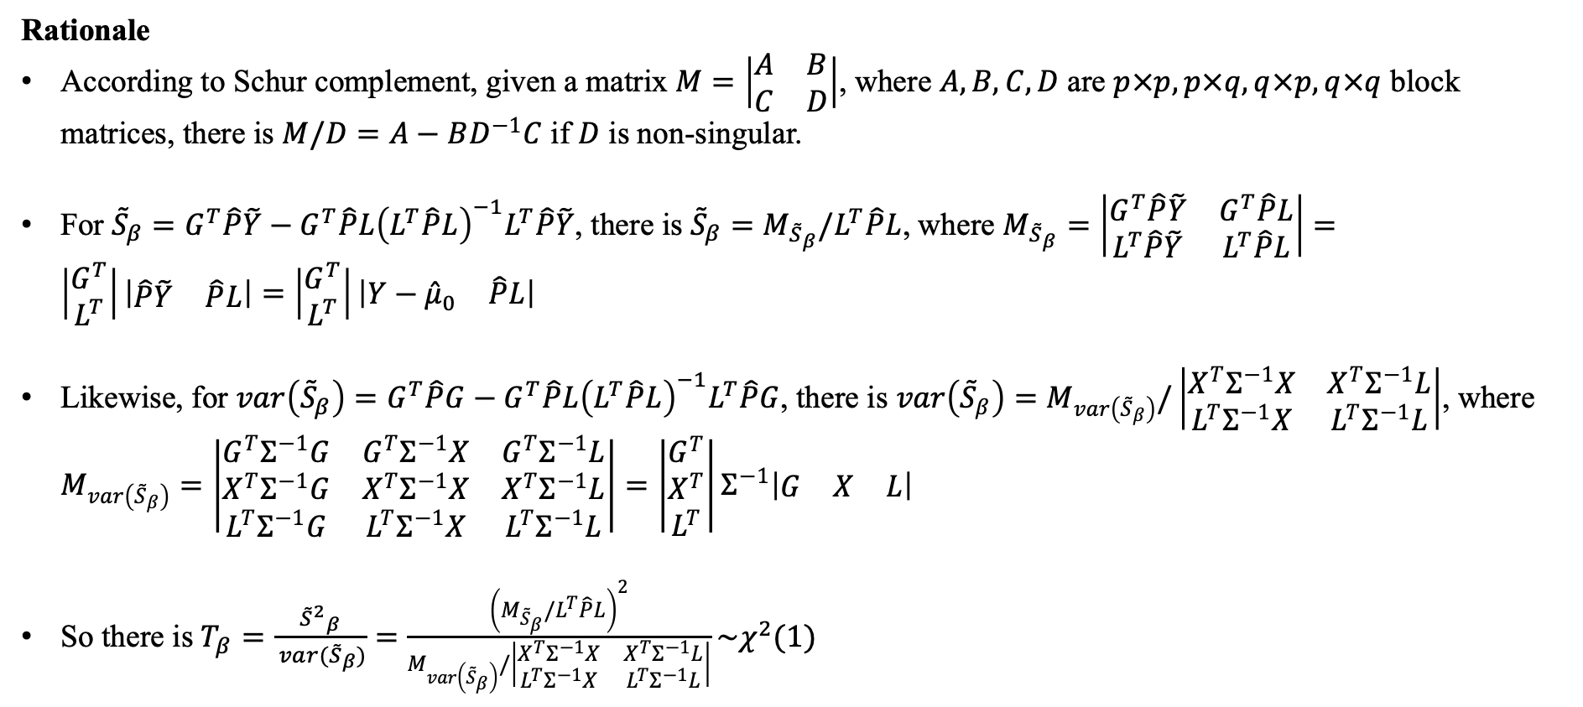
Aim 2: Develop local-ancestry-aware GWAS models
Rationale
According to Schur complement, given a matrix $M=\left|\begin{matrix}A & B \\ C & D\end{matrix}\right|$, where $A, B, C,D$ are $p×p, p×q, q×p, q×q$ block matrices, there is $M/D=A−BD^{−1}C$ if $D$ is non-singular.
For ${\tilde{S}}_{β}=G^{T}\hat{P}\tilde{Y}−G^{T}\hat{P}L{\left(L^{T}\hat{P}L\right)}^{−1}L^{T}\hat{P}\tilde{Y}$, there is ${\tilde{S}}_{β}=M_{{\tilde{S}}_{β}}/L^{T}\hat{P}L$, where $M_{{\tilde{S}}_{β}}=\left|\begin{matrix}G^{T}\hat{P}\tilde{Y} & G^{T}\hat{P}L \\ L^{T}\hat{P}\tilde{Y} & L^{T}\hat{P}L\end{matrix}\right|=\left|\begin{matrix}G^{T} \\ L^{T}\end{matrix}\right|\left|\begin{matrix}\hat{P}\tilde{Y} & \hat{P}L\end{matrix}\right|=\left|\begin{matrix}G^{T} \\ L^{T}\end{matrix}\right|\left|\begin{matrix}Y−{\hat{μ}}_{0} & \hat{P}L\end{matrix}\right|$
Likewise, for $var\left({\tilde{S}}_{β}\right)=G^{T}\hat{P}G−G^{T}\hat{P}L{\left(L^{T}\hat{P}L\right)}^{−1}L^{T}\hat{P}G$, there is $var\left({\tilde{S}}_{β}\right)=M_{var\left({\tilde{S}}_{β}\right)}/\left|\begin{matrix}X^{T}Σ^{−1}X & X^{T}Σ^{−1}L \\ L^{T}Σ^{−1}X & L^{T}Σ^{−1}L\end{matrix}\right|$, where $M_{var\left({\tilde{S}}_{β}\right)}=\left|\begin{matrix}G^{T}Σ^{−1}G & G^{T}Σ^{−1}X & G^{T}Σ^{−1}L \\ X^{T}Σ^{−1}G & X^{T}Σ^{−1}X & X^{T}Σ^{−1}L \\ L^{T}Σ^{−1}G & L^{T}Σ^{−1}X & L^{T}Σ^{−1}L\end{matrix}\right|=\left|\begin{matrix}G^{T} \\ X^{T} \\ L^{T}\end{matrix}\right|Σ^{−1}\left|\begin{matrix}G & X & L\end{matrix}\right|$
So there is $T_{β}=\frac{{{\tilde{S}}^{2}}_{β}}{ var({\tilde{S}}_{β})}=\frac{{\left(M_{{\tilde{S}}_{β}}/L^{T}\hat{P}L\right)}^{2}}{M_{var\left({\tilde{S}}_{β}\right)}/\left|\begin{matrix}X^{T}Σ^{−1}X & X^{T}Σ^{−1}L \\ L^{T}Σ^{−1}X & L^{T}Σ^{−1}L\end{matrix}\right|}\sim χ^{2}(1)$
$X_{g/l}=global/local ancestry coordinateswith the top J PCs , b=random effect accounting for sample relatedness, C=covariates, G=genotype vector, Y=phenotype vector,g\left(∙\right)=link function, μ=conditional expectation of Y under different situations, φ=dispersion parameter$
Notes:
Let’s first denote Y tilde as the working vector, P hat as the projection matrix from the global null model, sigma hat as the total variation of phenotypes, and phi as the dispersion parameter in GLMM. We will have the difference between Y and mu zero divided by phi hat equals p hat times Y tilde according to annihilation projection. And thus we can successfully build the association between s beta tilde, s beta and s gamma. And we will have the score test statistics equals the square of s beta tilde divided by its variance, which complies with chi-square distribution with df = 1.

Slide 27
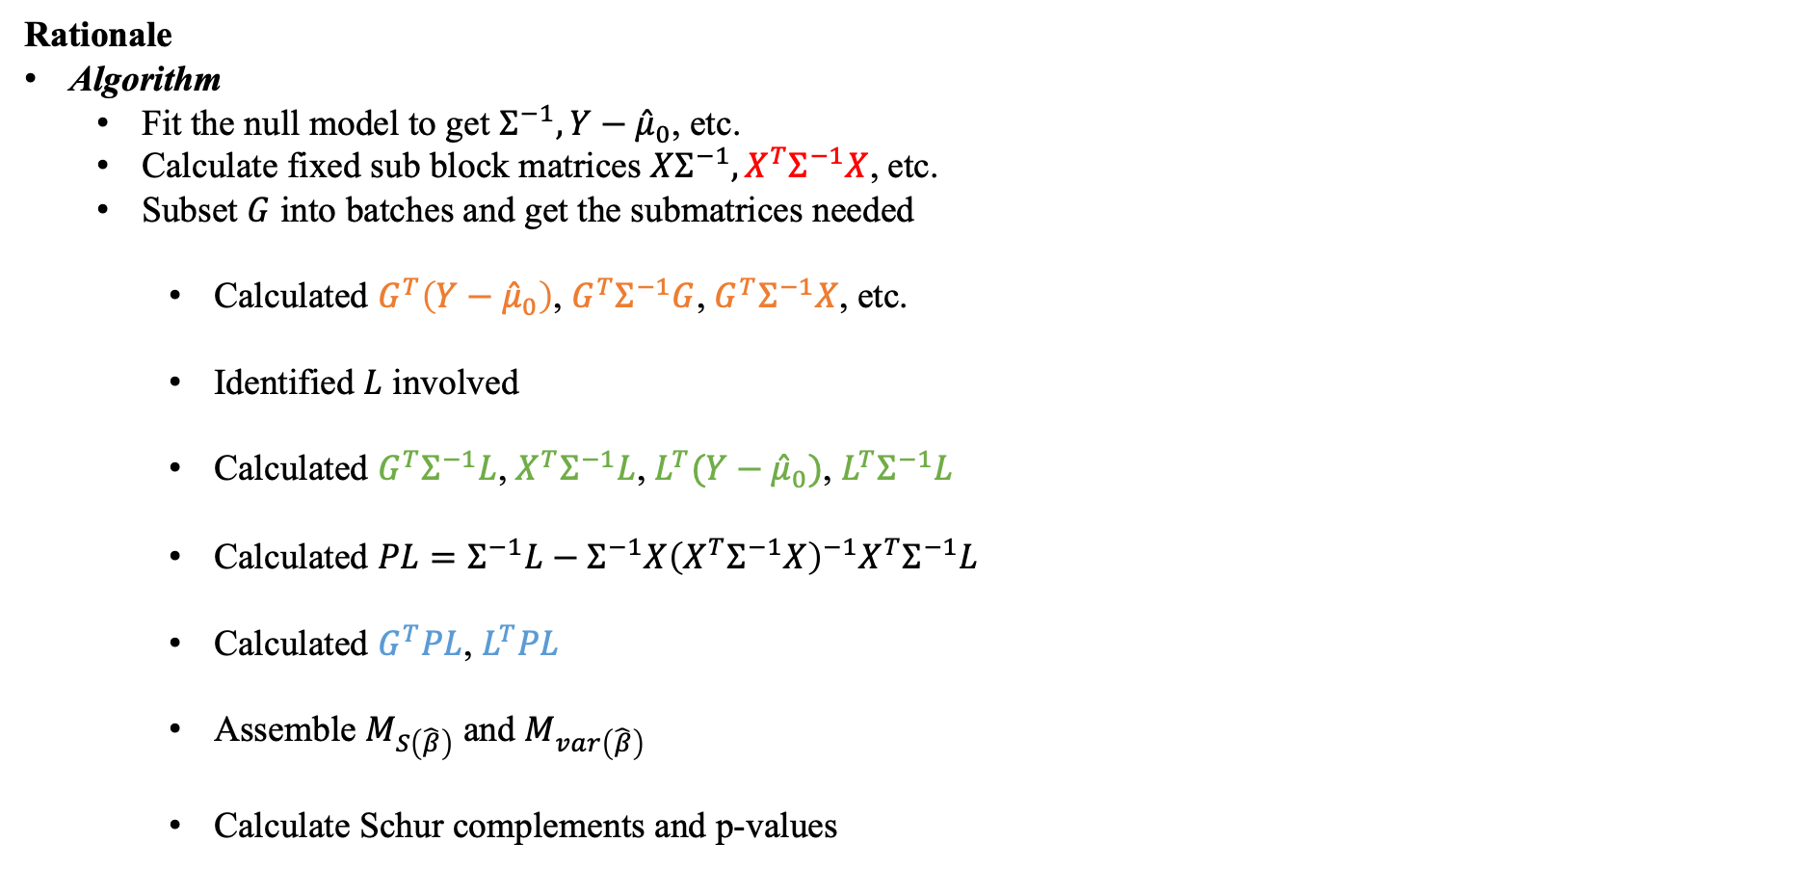

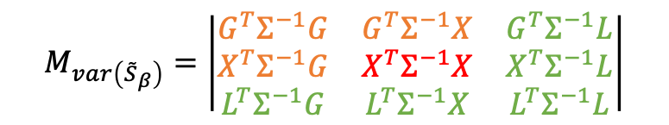
Aim 2: Develop local-ancestry-aware GWAS models
Rationale
Algorithm
Fit the null model to get $Σ^{−1}, Y−{\hat{μ}}_{0}$, etc.
Calculate fixed sub block matrices $XΣ^{−1}, X^{T}Σ^{−1}X$, etc.
Subset $G$ into batches and get the submatrices needed
Calculated $G^{T}\left(Y−{\hat{μ}}_{0}\right)$, $G^{T}Σ^{−1}G$, $G^{T}Σ^{−1}X$, etc.
Identified $L$ involved
Calculated $G^{T}Σ^{−1}L$, $X^{T}Σ^{−1}L$, $L^{T}(Y−{\hat{μ}}_{0})$, $L^{T}Σ^{−1}L$
Calculated $PL=Σ^{−1}L−Σ^{−1}X{\left(X^{T}Σ^{−1}X\right)}^{−1}X^{T}Σ^{−1}L$
Calculated $G^{T}PL$, $L^{T}PL$
Assemble $M_{S\left(\hat{β}\right)}$ and $M_{var\left(\hat{β}\right)}$
Calculate Schur complements and p-values
$$M_{{\tilde{S}}_{β}}=\left|\begin{matrix}G^{T}\left(Y−{\hat{μ}}_{0}\right) & G^{T}\hat{P}L \\ L^{T}\left(Y−{\hat{μ}}_{0}\right) & L^{T}\hat{P}L\end{matrix}\right|$$
$$M_{var\left({\tilde{S}}_{β}\right)}=\left|\begin{matrix}G^{T}Σ^{−1}G & G^{T}Σ^{−1}X & G^{T}Σ^{−1}L \\ X^{T}Σ^{−1}G & X^{T}Σ^{−1}X & X^{T}Σ^{−1}L \\ L^{T}Σ^{−1}G & L^{T}Σ^{−1}X & L^{T}Σ^{−1}L\end{matrix}\right|$$
$X_{g/l}=global/local ancestry coordinateswith the top J PCs , b=random effect accounting for sample relatedness, C=covariates, G=genotype vector, Y=phenotype vector,g\left(∙\right)=link function, μ=conditional expectation of Y under different situations, φ=dispersion parameter$
Notes:
Let’s first denote Y tilde as the working vector, P hat as the projection matrix from the global null model, sigma hat as the total variation of phenotypes, and phi as the dispersion parameter in GLMM. We will have the difference between Y and mu zero divided by phi hat equals p hat times Y tilde according to annihilation projection. And thus we can successfully build the association between s beta tilde, s beta and s gamma. And we will have the score test statistics equals the square of s beta tilde divided by its variance, which complies with chi-square distribution with df = 1.

Slide 28
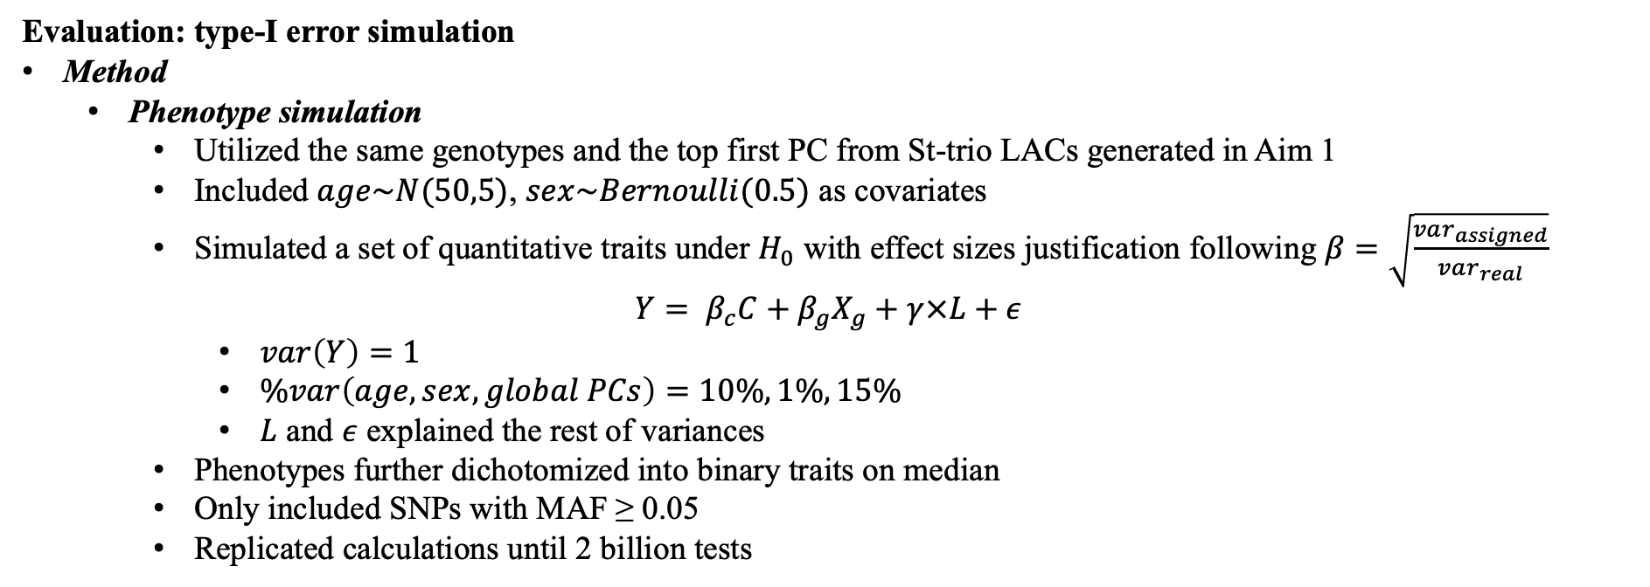
Aim 2: Develop local-ancestry-aware GWAS models
Evaluation: type-I error simulation
Method
Phenotype simulation
Utilized the same genotypes and the top first PC from St-trio LACs generated in Aim 1
Included $age\sim N(50,5)$, $sex\sim Bernoulli(0.5)$ as covariates
Simulated a set of quantitative traits under $H_{0}$ with effect sizes justification following $β=\sqrt{\frac{var_{assigned}}{var_{real}}}$
$$Y= β_{c}C+β_{g}X_{g}+γ×L+ε$$
$var\left(Y\right)=1$
$\%var\left(age,sex,global PCs\right)=10\%, 1\%, 15\%$
$L$ and $ε$ explained the rest of variances
Phenotypes further dichotomized into binary traits on median
Only included SNPs with MAF ≥ 0.05
Replicated calculations until 2 billion tests
$X_{g/l}=global/local ancestry coordinateswith the top J PCs , C=covariates, γ=local ancestry effects, L=orthogonalized local deviation, Y=phenotype vector, ε=random error$

Slide 29
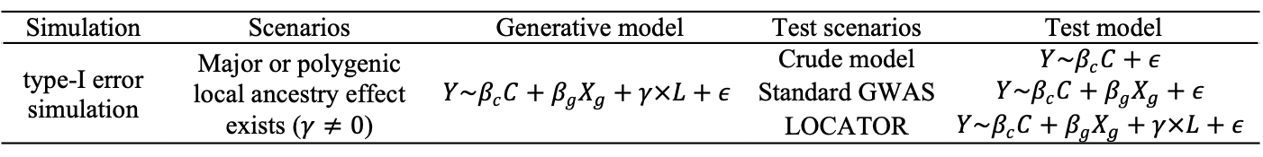
Aim 2: Develop local-ancestry-aware GWAS models
Evaluation: type-I error simulation
Method
Application scenarios
Major local ancestry effect, e.g., white blood cell counts (Shriner et al. 2015)
Polygenic local ancestry effect, e.g., hypertension, type-2 diabetes
Testing models
Crude model: no control for population structure
Standard GWAS: only account for global ancestry effects
LOCATOR: account for both global and local ancestry effects
Table 12. Local-ancestry-aware phenotype simulation
Local ancestry effects | Number of LACs | Variance explained LACs | Variance per LACs | Type of phenotypes
Major effects | 2 | 20% | 10% | Quantitative traits
Polygenic effects | 50 | 5% | 0.1% | Quantitative traits
Polygenic effects | 50 | 5% | 0.1% | Binary traits
Table 13. Testing models in type-I error simulation
Simulation | Scenarios | Generative model | Test scenarios | Test model
type-I error simulation | Major or polygenic local ancestry effect exists ($γ≠0$) | $$Y\sim β_{c}C+β_{g}X_{g}+γ×L+ε$$ | Crude model | $$Y\sim β_{c}C+ε$$
 |  |  | Standard GWAS | $$Y\sim β_{c}C+β_{g}X_{g}+ε$$
 |  |  | LOCATOR | $$Y\sim β_{c}C+β_{g}X_{g}+γ×L+ε$$
$X_{g/l}=global/local ancestry coordinateswith the top J PCs , C=covariates, γ=local ancestry effects, L=orthogonalized local deviation, Y=phenotype vector, ε=random error$

Slide 30
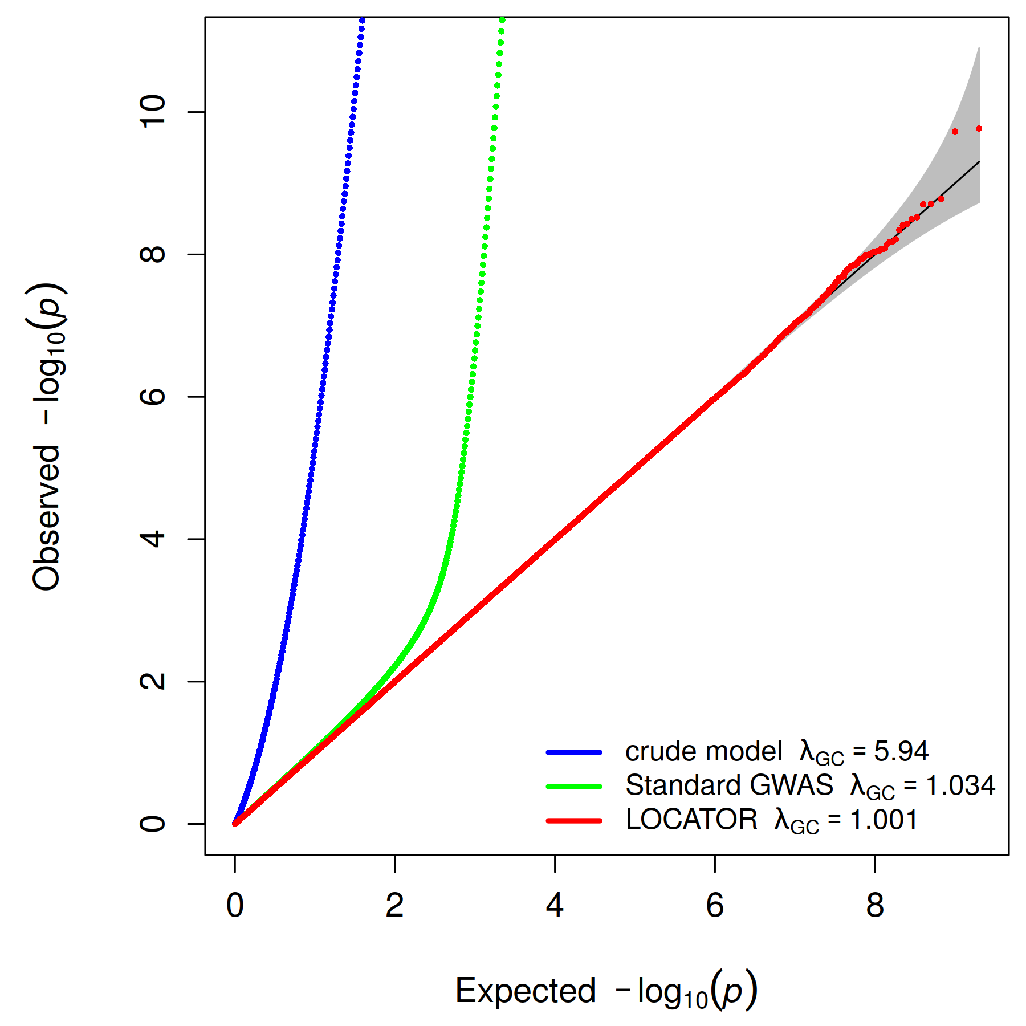
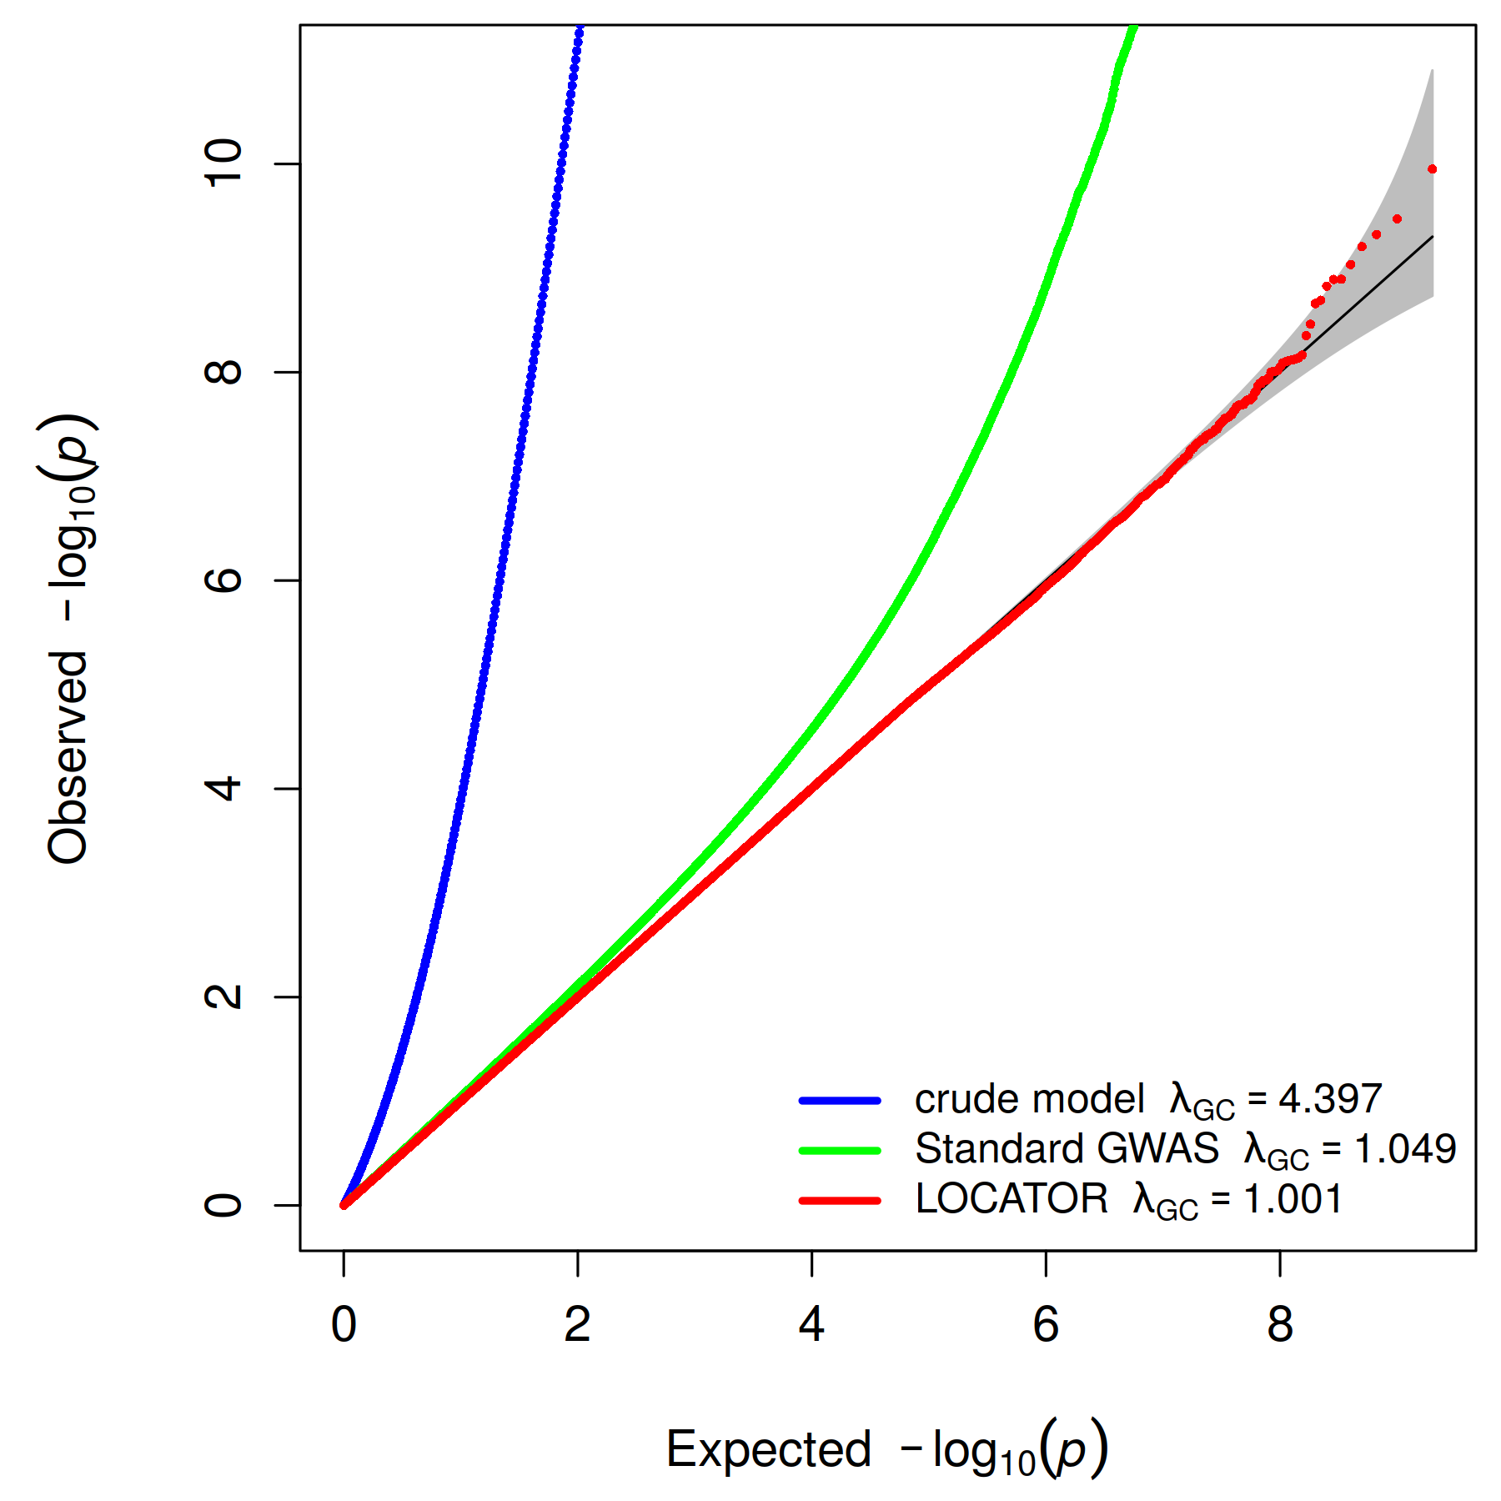
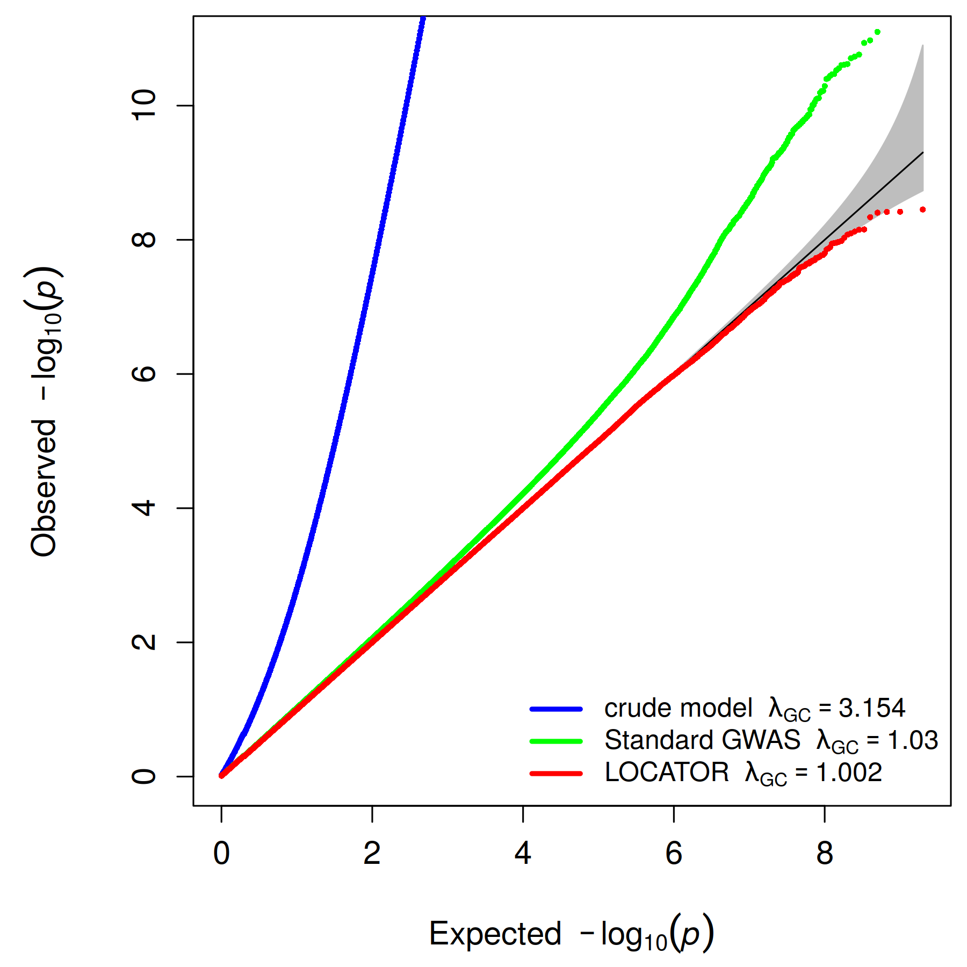
Aim 2: Develop local-ancestry-aware GWAS models
Results
Performance
6479485 eligible SNPs included and 309 replicates completed
Extents of inflation: crude model > standard GWAS > LOCATOR
LOCATOR is able to control the type-I error rate
a) Major effects
b) Polygenic effects – quantitative traits
c) Polygenic effects – binary traits
Fig 16. Type-I error simulation

Slide 31
Aim 2: Develop local-ancestry-aware GWAS models
Future work
We will examine why LOCATOR is much faster with a higher computational complexity
We will include the first two PCs to examine
Tr-duo LACs
AMR-free LACs
Standard LACs
Raw local ancestry estimates
Whether misclassified LACs is still robust enough to account for local ancestry effects
Extent of benefits from continuous ancestry assignment

Slide 32
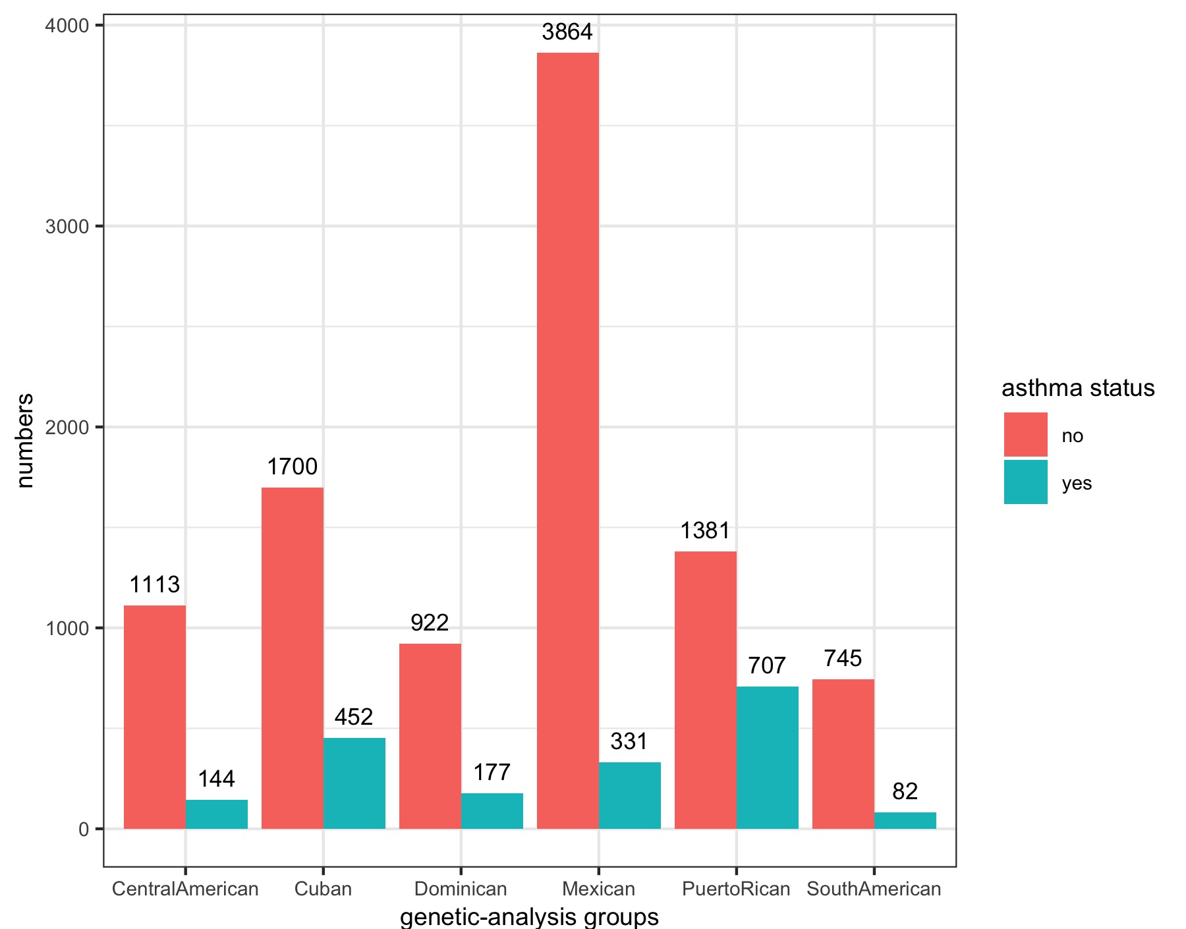
Aim 3: Detect asthma-associated susceptible loci in HCHS/SOL
Introduction
Hispanic paradox
Hispanics disproportionately suffer from asthma (~2.3 Million) compared to EUR and AFR
Within Hispanics, Puerto Ricans (14.0%) are as twice more likely to develop asthma as Mexican Americans (4.4%)
Strong evidence of population stratification
Few GWAS studies learnt Hispanic cohorts, nor Hispanic-specific susceptible loci were identified
Data
Hispanic Community Health Study/Study of Latinos (HCHS/SOL) cohort
16385 participants aging from 18 – 74 recruited during 2006 – 2011 to study heart and lung diseases
Self-identified with Central American, Cuban, Dominican, Mexican, Puerto Rican, and South American background
Few prior asthma-related GWAS studies conducted
Fig 17. Distribution of asthma status in HCHS/SOL

Slide 33
Aim 3: Detect asthma-associated susceptible loci in HCHS/SOL
Application
Inclusion criteria
Included participants who granted consent and whose LAI, asthma status, and global PCs were available
Developing asthma: self-reported asthma with medical diagnosis
Included SNP with MAF ≥ 0.01
Models
Fixed effects: age, sex, Hispanic background indicators, field center indicators, cigarette use, cigarette pack years, sampling weights
Random effects: sample relatedness, household, block memberships
Standard GWAS: adjusted with global PCs
LOCATOR: adjusted with global PCs and Orthogonalized local deviations
Signal check
Conditional analysis: additionally adjusted allele frequencies and LACs of the peak SNP
Sensitivity analysis: additionally treated Orthogonalized local deviations as fixed effects in the standard GWAS

Slide 34
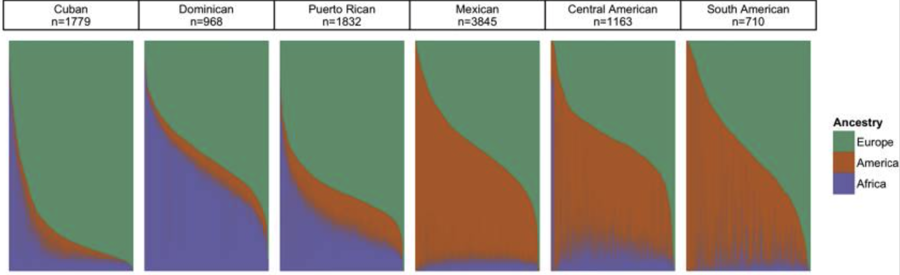
Aim 3: Detect asthma-associated susceptible loci in HCHS/SOL
Results
demographics
11618 eligible participants included, with 11359 participants with complete data entry
1257, 2152, 1099, 4185, 2088, 827 participants were reported having Central American, Cuban, Dominican, Mexican, Puerto Rican, South American background
Cubans, Dominicans, Puerto Ricans are more EUR-AFR admixed, while Central Americans, Mexicans, South Americans are more EUR-AMR admixed
Table 14. Continental global ancestry distribution among subgroups in HCHS/SOL
Hispanic background groups | mean
 | AFR | AMR | EUR
Central American | 0.1070 | 0.4510 | 0.4420
Cuban | 0.1550 | 0.0578 | 0.7870
Dominican | 0.4390 | 0.0651 | 0.4960
Mexican | 0.0436 | 0.4890 | 0.4680
Puerto Rican | 0.2200 | 0.1390 | 0.6420
South American | 0.0642 | 0.4480 | 0.4880
Overall | 0.1425 | 0.2979 | 0.5596
Fig 18. Admixture proportions among subgroups in HCHS/SOL
(cr: Conomous et al. Am J Hum Genet.)

Slide 35
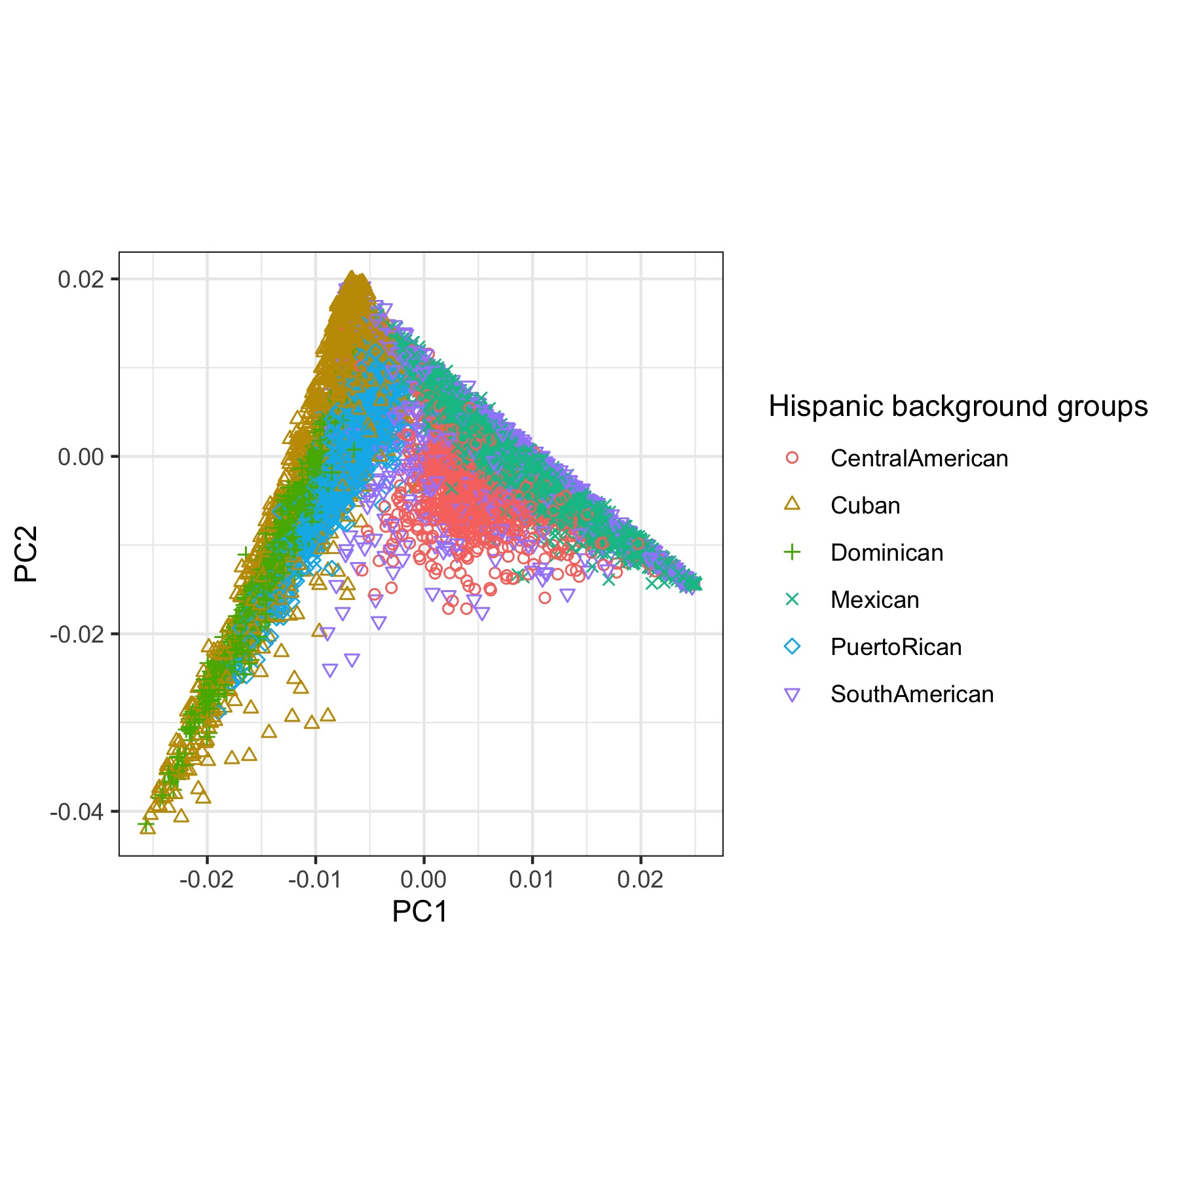
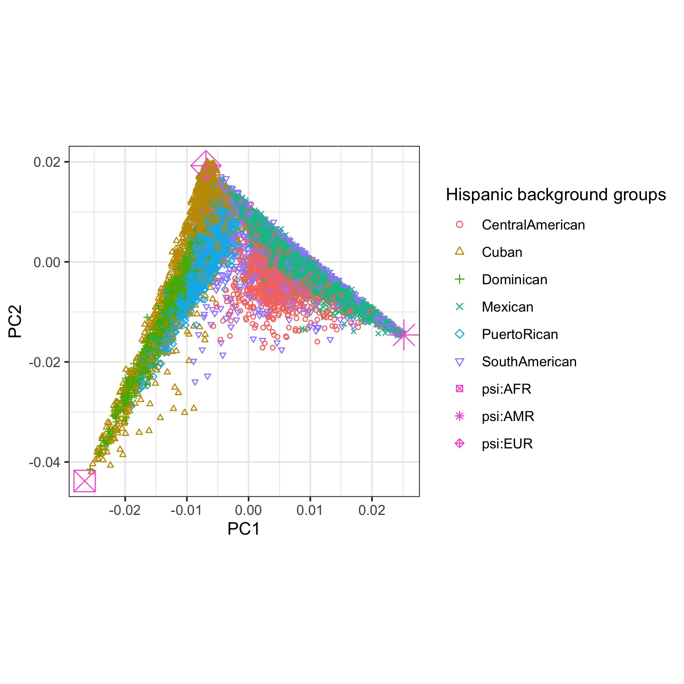
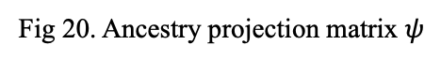
Aim 3: Detect asthma-associated susceptible loci in HCHS/SOL
Results
Global PCs and the ancestry projection matrix $ψ$
Fig 19. Global PCs
Fig 20. Ancestry projection matrix $ψ$

Slide 36
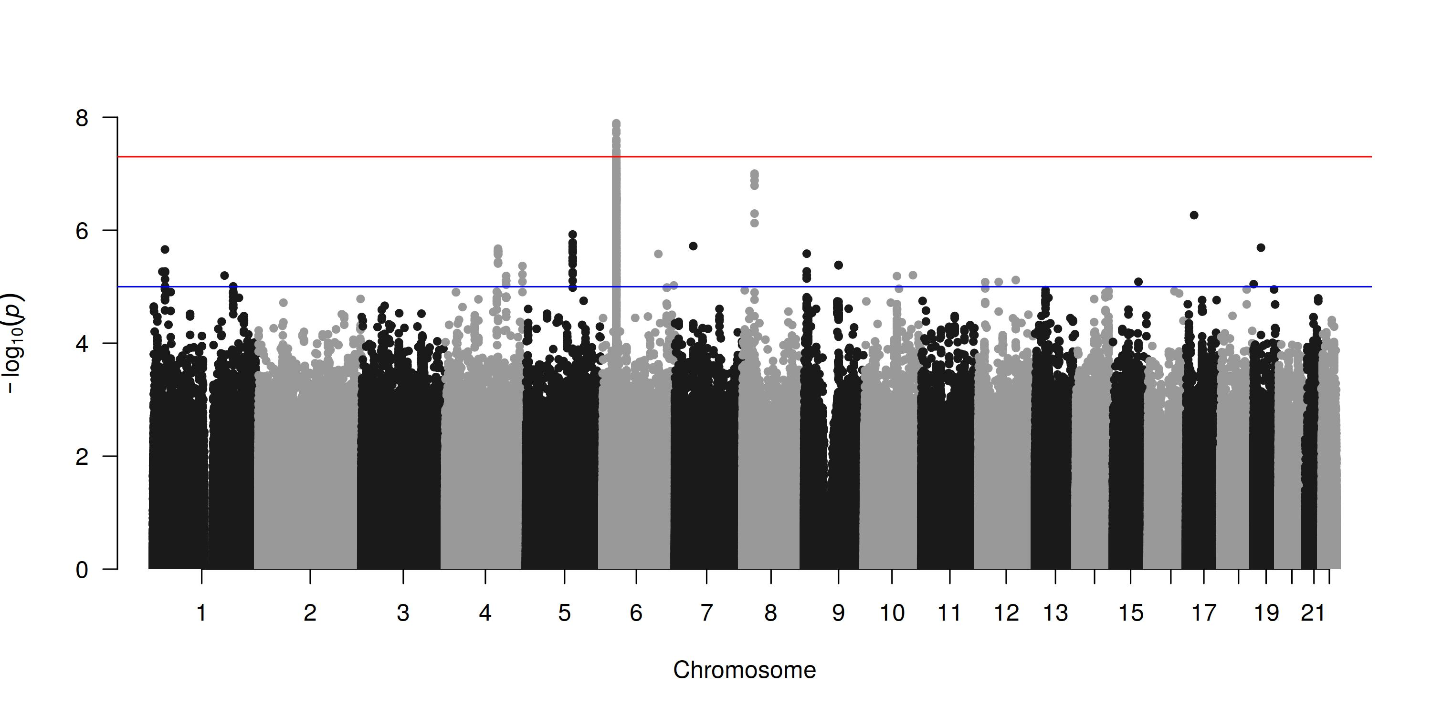
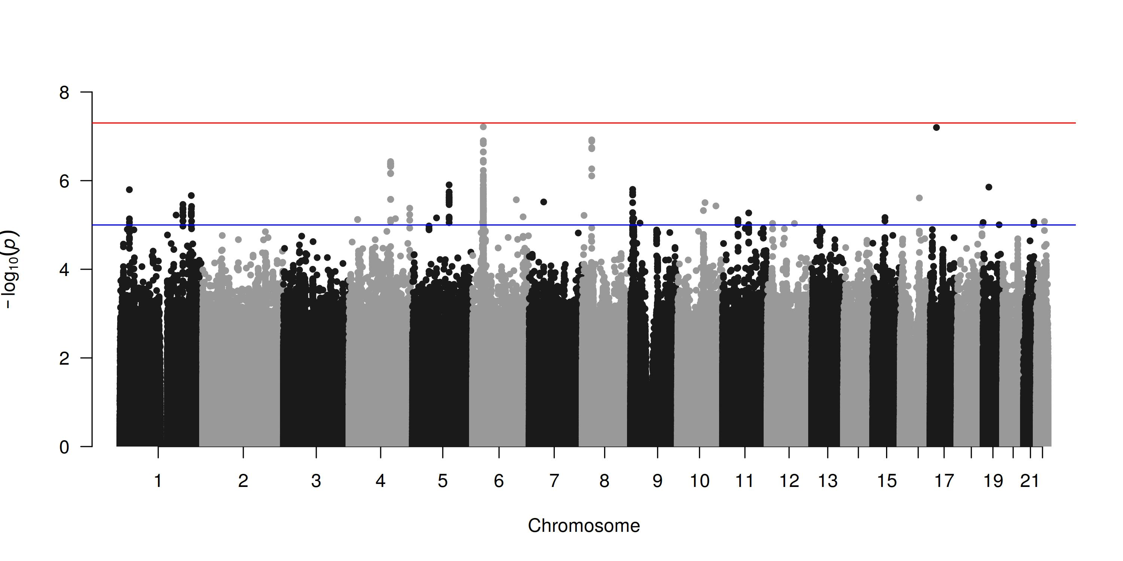
Aim 3: Detect asthma-associated susceptible loci in HCHS/SOL
Results
Manhattan plots
A significant band with 19 significant SNPs identified
Lasts 29 kbp and locates within HLA-DQ on chr6
a) LOCATOR
b) Standard GWAS
Fig 21. Manhattan plots

Slide 37
Aim 3: Detect asthma-associated susceptible loci in HCHS/SOL
Results
Peak SNP rs9273400 (6:32627128)
Table 15. Significant SNPs on chr6
SNP | chr | Location¹ | ref | alt | miss rate | allele frequency | LOCATOR |  | Standard GWAS |  | gene
 |  |  |  |  |  |  | OR (95% CI) | p-value | OR (95% CI) | p-value
rs1047989 | 6 | 32605257 | A | C | 0 | 0.4242 | 0.8039 (0.7756 – 0.8333) | 2.65E-08 | 0.8311 (0.8045 – 0.8585) | 1.55E-06 | HLA-DQA1
rs9272508 | 6 | 32606325 | A | G | 0 | 0.4304 | 0.7955 (0.7659 – 0.8264) | 1.71E-08 | 0.8234 (0.7956 – 0.8522) | 1.02E-06 | HLA-DQA1
rs9272587 | 6 | 32607510 | A | G | 0 | 0.3894 | 0.7951 (0.7643 – 0.8271) | 4.86E-08 | 0.8328 (0.8049 – 0.8616) | 6.64E-06 | HLA-DQA1
rs9272589 | 6 | 32607524 | C | T | 0 | 0.3858 | 0.7932 (0.7624 – 0.8252) | 3.23E-08 | 0.8301 (0.8021 – 0.8591) | 4.41E-06 | HLA-DQA1
rs116150265 | 6 | 32607526 | C | T | 0 | 0.3858 | 0.7932 (0.7624 – 0.8252) | 3.23E-08 | 0.8301 (0.8021 – 0.8591) | 4.41E-06 | HLA-DQA1
rs9272958 | 6 | 32611170 | A | C | 0 | 0.3745 | 0.7877 (0.7563 – 0.8204) | 1.91E-08 | 0.8334 (0.8056 – 0.8622) | 7.06E-06 | HLA-DQA1
rs9272969 | 6 | 32611289 | G | A | 0 | 0.3675 | 0.7923 (0.7617 – 0.8242) | 2.47E-08 | 0.8312 (0.8034 – 0.8599) | 4.39E-06 | HLA-DQA1
rs17843604 | 6 | 32620283 | T | C | 0 | 0.4243 | 0.8010 (0.7726 – 0.8304) | 1.38E-08 | 0.8286 (0.8020 – 0.8561) | 9.48E-07
rs17612774 | 6 | 32620286 | C | T | 0 | 0.4588 | 0.8032 (0.7744 – 0.8331) | 3.92E-08 | 0.8335 (0.8068 – 0.8612) | 3.07E-06
rs17843621 | 6 | 32620827 | T | C | 0 | 0.3857 | 0.7924 (0.7611 – 0.8249) | 4.71E-08 | 0.8360 (0.8082 – 0.8649) | 1.18E-05
rs17612893 | 6 | 32620836 | T | A | 0 | 0.3912 | 0.7897 (0.7584 – 0.8223) | 2.62E-08 | 0.8311 (0.8030 – 0.8602) | 5.90E-06
rs17612900 | 6 | 32620838 | C | G | 0 | 0.3912 | 0.7897 (0.7584 – 0.8222) | 2.62E-08 | 0.8311 (0.8030 – 0.8602) | 5.90E-06
rs9273314 | 6 | 32622986 | C | T | 0 | 0.4240 | 0.7985 (0.7685 – 0.8298) | 4.96E-08 | 0.8281 (0.8002 – 0.8571) | 2.94E-06
rs9273315 | 6 | 32622990 | T | C | 0 | 0.4241 | 0.7985 (0.7685 – 0.8298) | 4.96E-08 | 0.8281 (0.8002 – 0.8570) | 2.94E-06
rs9273380 | 6 | 32626895 | A | G | 0 | 0.3462 | 0.7962 (0.7659 – 0.8278) | 4.18E-08 | 0.8351 (0.8077 – 0.8634) | 6.91E-06
rs9273400 | 6 | 32627128 | C | T | 0 | 0.4878 | 1.2534 (1.2079 – 1.3007) | 1.28E-08 | 1.2392 (1.1954 – 1.2845) | 6.11E-08
rs9273405 | 6 | 32627175 | C | A | 0 | 0.3860 | 0.7923 (0.7611 – 0.8248) | 4.17E-08 | 0.8340 (0.8061 – 0.8629) | 8.55E-06
rs9273441 | 6 | 32627573 | G | C | 0 | 0.3483 | 0.7946 (0.7642 – 0.8262) | 3.11E-08 | 0.8329 (0.8054 – 0 .8613) | 4.92E-06 | HLA-DQB1
rs9274501 | 6 | 32634032 | G | A | 0 | 0.3489 | 0.7957 (0.7651 – 0.8275) | 4.70E-08 | 0.8386 (0.8114 – 0.8667) | 1.12E-05
*: Genome built in GRCH 37.

Slide 38


Aim 3: Detect asthma-associated susceptible loci in HCHS/SOL
Results
Running time
Total running time = null model fitting + p-value calculation
P-value calculation: LOCATOR: 431.14 hours, standard GWAS: 428.31 hours
Null model fitting (single): LOCATOR: 12.34 hours, LAI: 13.07 hours
Table 16. Running time composition of GWAS testing models
Model | Composition
Standard GWAS with global PCs | 1 null model fitting + p-value calculation
Standard GWAS with local ancestry | 14815 null model fitting + p-value calculation
LOCATOR | 1 null model fitting + p-value calculation
a) p-value calculation running time
b) null model fitting running time
Fig 21. Total CPU time

Slide 39



Aim 3: Detect asthma-associated susceptible loci in HCHS/SOL
Results
Signal check
No significant SNPs after conditioning
$β$s are almost equivalent
Fig 23. Manhattan plot of conditional analysis on chr6
Fig 24. Regression coefficients of sensitivity analysis on chr6

Slide 40
Aim 3: Detect asthma-associated susceptible loci in HCHS/SOL
Results
Snapshot of LACs
The 214th LACs on chr6 (chr6:32569691-32711178) evolved
Proportions of AFR, AMR, EUR are 0.1915, 0.2567, 0.5518
%AFR and %AMR are only marginally associated with asthma, while PC1 is significantly associated
Table 16. Association between asthma and local ancestry measures at rs9273400
Terms | OR (95% CI) | 1-df p-value | 2-df p-value
Model 1: adjusting with proportions of AFR and AMR
%AFR | 1.2400 (1.0152 – 1.5146) | 0.0175 | 0.0041
%AMR | 0.7737 (0.6130 – 0.9766) | 0.0154
Model 2: adjusting with PC1 and PC2
PC1 | 0.0002 (0 – 0.0380) | 0.0008 | 0.0034
PC2 | 0.6240 (0.0244 – 15.9596) | 0.3878
Table 17. Distribution of Hispanic background groups at rs9273400
PC1 | PC2 | Local ancestry |  |  | Hispanic background subgroups |  |  |  |  |  | Sample size
 |  | AFR | AMR | EUR | Central American | Cuban | Dominican | Mexican | Puerto Rican | South American
-0.027 | -0.042 | 1 | 0 | 0 | 35 | 143 | 256 | 40 | 187 | 9 | 670
-0.017 | -0.010 | 0.5 | 0 | 0.5 | 167 | 534 | 460 | 361 | 741 | 71 | 2334
-0.007 | 0.021 | 0 | 0 | 1 | 270 | 1199 | 258 | 1039 | 747 | 246 | 3759
-0.001 | -0.027 | 0.5 | 0.5 | 0 | 150 | 50 | 55 | 274 | 102 | 46 | 677
0.009 | 0.004 | 0 | 0.5 | 0.5 | 405 | 186 | 53 | 1516 | 248 | 276 | 2684
0.025 | -0.013 | 0 | 1 | 0 | 202 | 6 | 6 | 830 | 24 | 167 | 1235

Slide 41


Aim 3: Detect asthma-associated susceptible loci in HCHS/SOL
Results
Snapshot of LACs
Asthma rates declines with increasing PC1
T allele frequency declines with increasing PC1
Fig 25. Asthma prevalence stratified by local ancestry at chr6:32627128
Fig 26. Allele frequency stratified by local ancestry at chr6:32627128

Slide 42


Aim 3: Detect asthma-associated susceptible loci in HCHS/SOL
Results
Limitations
PC1 vs PC3, 4 present subgroup patterns in global PCs
Only 3-way continental local ancestry available
No fine resolution to support further population stratification controls
Table 18. Ancestry composition of Hispanic background groups
Ancestry | Central American | Cuban | Dominican | Mexican | Puerto Rican | South American
AFR | Minor | Sub-Saharan African | Sub-Saharan African | Minor | West Coast African | Minor
AMR | Central American | Taino | Taino | Central American | Taino | Andean and Southern American
EUR | Iberian and Southern European | Iberian | Western European | Iberian and Southern European | Iberian | Iberian and Southern European
Fig 27. Distribution of the ancestry projection matrix $ψ$ in PC1 vs. PC3
Fig 28. Distribution of local ancestry at chr6:32627128 in PC1 vs. PC3

Slide 43
Summary
Summary
Aim1
Continuous local ancestry measure LACs
Projecting local ancestry into a reference-based global PC-spanned space
Accurately extract local ancestry characteristics
Resist local ancestry misclassification due to incomplete reference panels
A comprehensive reference panel is preferred
Aim2
Local-ancestry-aware GWAS model LOCATOR
Better type-I error control compared to standard GWAS and crude GWAS
Can control type-I error rates in both major and polygenic local ancestry effects
Aim3
A novel association between asthma and HLA-DQ region in Hispanic populations
PC1 from LACs strongly associated with asthma at the peak SNP
Declining tendency between asthma, T allele frequency and PC1 at the peak SNP
LOCATOR took less time in fitting null models and the same time in calculating p-values
Resolution of LAI matters

Slide 44

Summary
Limitations
Improper application scenarios
Inapplicable to studies when Genotype/global PCs data is unavailable, e.g., candidate gene, targeted sequencing
No need to perform local-ancestry-aware GWAS if there is no confounding by population structure
True local ancestry effect might be misclassified in LOCATOR
Moderately relies on local ancestry input
Reference panel
LOCATOR might still be underpowered due to possible breakpoints misclassification by LAI software, e.g., RFMix
Predicted breakpoints in LAI
Fig 30. Demonstration of universal breakpoints (raw figure cr: gnomeAD)

Slide 45

Summary
Future work
Potential scenarios
Relevant local-ancestry-aware applications: Polygenic risk scores (PRS), Mendelian Randomization (MR), etc.
Single-cell level associations
Reference-based projection scheme
Theoretically applicable to scenarios which complies with global-local linear relationship, e.g. spatial-omics
Fig 31. Spatial-Omics (cr. Broad Institution)

Slide 46

Supplement
Application on single-cell data (Human Cell Atlas Project)
Goals
Characterize genetic factors underlying neurodegenerative diseases incorporating both WGS and NGS
Rationale
Restrict SNP testing windows according to sc-ATAC peaks
Combine single cells into meta cells to reduce dropout effects according to cell distances
Workflow overview
sc-ATAC
test region
local ancestry
Fig 32. Demonstration of test region (raw figure cr. 10x Genomics)
WGS
Genotype phasing and imputation
Local ancestry inference
sc-RNA
Meta cell integration
Genotype kernel association test
NGS
sc-ATAC
Transcription peaks

Slide 47
Acknowledgements
Committee Members:
Michael D. Swartz, PhD (committee chair/academic advisor)
Han Chen, PhD (dissertation supervisor/minor advisor)
Goo Jun, PhD (breadth advisor)
External reviewers:
Paul de Vries, PhD (external reviewer)
Staff members:
Jin Zhou
Adolescence Vaccine Project Implementation (AVP-IT) group:
Ross Shegog, PhD
Erica M. Frost, MPH
Laura C. Thormaehlen, MPH
Hina Adam, MD
Aadeel Khawaja, MD
Lillian Diaz, MPH
Lara Savas, PhD
Laura A. Shay, PhD

Slide 48
Thanks for your listening!
Any questions welcomed

